Slide 1
U.C. Berkeley: Economics 115: Spring 2020
20th Century Economic History: Lecture 17: East Asia’s Rise
Brad DeLong
Department of Economics & Blum Center, U.C. Berkeley; & WCEG
delong@econ.berkeley.edu
last revised: 2020-03-24
for delivery: 2020-04-20
<https://bcourses.berkeley.edu/courses/1487684>
<https://github.com/braddelong/public-files/blob/master/econ-115-lecture-17.pptx>

Slide 2

East Asian Miracles
The Setting:
Asia on the “downside” of the Malthusian cycle when western Europe erupts into the eastern Pacific in the 1800s
Malthusian poverty means no middle class to demand domestic manufactures
Power gradient means no ability to impose tariffs
Lack of a powerful bourgeoisie means rule by princes for whom intensive economic growth is not a priority
“Confucian” religion means right orientation more important than rationalization of techniques and methods
As Melissas Dell says: if we were sitting here in the 1950s, we would not have predicted the East Asian Miracle:
South Korea was a basket case, with a highly corrupt government, that people assumed would be permanently dependent on foreign aid
The other Tigers weren’t faring much better
We would have likely guessed, if anything, that the Philippines would be the growth miracle:
It had the highest rates of education (primary, second, and tertiary) in Asia
It had the highest rates of indigenous entrepreneurship
And it had its health-care sector and other links with the US
36:00 minutes of audio
2:15
Notes:
East Asia was on the downside of the Malthusian cycle when western Europe erupted into the eastern Pacific in the 1800s: populous, with many ingenious and efficient non-machine technologies for squeezing output out of very limited resources, but desperately poor. “The West” brought machine technologies and the global market. It also brought a measure of contempt for east Asian civilizations. Nearly all western observers thought the idea that the Mysterious East might catch up to the north Atlantic in any reasonable historical timeframe was absolutely ludicrous.
Malthusian poverty meant no domestic middle-class to demand domestic manufactures, and productivity levels in Asia were hopeless as far as manufactured exports were concerned. The military and political power gradient vis-à-vis the north Atlantic meant no ability to impose tariffs, even had a domestic middle class on whose demand one might be able to build a community of engineering practice and progress existed. The lack of a powerful domestic bourgeoisie meant rule by princes for whom broad-based economic growth was simply not a priority. And in general a “Confucian” religious orientation meant that right orientation was more important than the rationalization of techniques and methods.
As Melissa Dale says: If we were sitting here in the 1950s, we would not have predicted anything like east Asia’s miracles.
Yet we have had four: first the early industrialization of Japan, then the extraordinary drive of Japan to global north status from 1950 to 1975, then the four east Asian tigers, and now coastal China.
All that surprises: As Melissa Dell says: As of 1950 the smart western money was that the Philippines was much more likely than even Japan to rapidly obtain global north status. The Philippines had the highest rates of education in Asia. The Philippines had the highest rates of indigenous entrepreneurship. In the Philippines head it's healthcare sector and other close economic links with America.

Slide 3
Principal Readings
Peter Evans (1995): Embedded Autonomy: States and Industrial Transformation, chapter 1 <https://delong.typepad.com/files/evans-embedded-i.pdf>
Yingyi Qian (2001): How Reform Worked in China <https://delong.typepad.com/files/qian-reform.pdf>

Slide 4
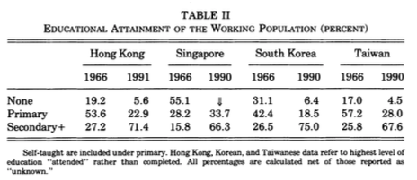
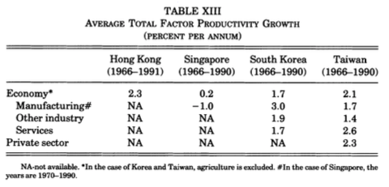
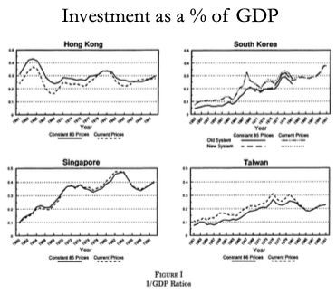
Proximate Causes of East Asian Miracles
Factor accumulation and technology transfer:
Factor accumulation
Highest savings rates in the world
Massive educational expansion
Rapid transfer from farm to city, and from agriculture to manufacturing
Where did demand for manufactured goods come from?
The Japanese state: rich country-strong army
The open world economy: neocolonial origins of comparative development
State capitalism with Chinese characteristics (and utopian socialist aspirations)
Yet also:
Getting institutions and incentives right
Success at technology transfer
Avoiding rent-seeking and other elite-corruption political economy traps
4:00
Notes:
What were the proximate causes of the east Asian miracles? Briefly, factor accumulation and technology transfer.
These economies grew in no small part through intensive factor accumulation: Education expanded massively. Their savings rates were the highest in the world. Hours worked were quite high. There was an extremely rapid transfer of workers from the farm to the city, and from low marginal value agriculture to constant and higher marginal value manufacturing.
Where did the demand for manufactured goods come from? Initially, in Meiji and post-Meiji Japan, from the state: The focus was on revering the emperor and expelling the barbarians, which required building a rich country that could build a strong army. The revenues of the aristocratic samurai class were confiscated by the state, and the samurai bought off by government bonds, the value of which was then inflated away. The government revenues were then used to fund the building of roads and factories. Later on, the growing Japanese middle class played a key role in demand.
After World War II—in Japan and in the four east Asian tigers—it was a combination of the opening world economy, and what Yingyi Qian and I call “neocolonial origins of comparative development”: It was very important for a United States fighting the Cold War that that part of east Asia that was in the “Free World” be prosperous and be seen to be prosperous. Thus export-oriented development strategies that would and did have run into nasty quota buzzsaws when pursued by Latin American and south Asian countries were welcomed when the exports came from east Asia. The United States was thus the importer of last resort for the east Asian development model.
This openness to exports channel was then amplified and reinforced by the Bush 41 and Clinton administration's decisions, even after the Tien an Men Square massacre, to hug China close: Generate as much contact as possible, economic, social, intellectual, and ideological, between the United States and the rising potential superpower across the ocean to the west. That seemed to provide the best road to a prosperous and peaceful 21st-century. That, after all had been Britain’s strategy over 1860-1945 with the then-rising potential superpower across the ocean to the west that was the United States. In Britain’s case, that strategy had been very successful.
Thus China's accession to the WTO and Chinese imports were greatly welcomed. Then came the decision of the Bush 43 government of the 2000s that its highest economic policy priority was a tax cut for the rich, funded by deficit spending and large-scale borrowing from China. That then carried with it the massive import flood of the China Shock, which was the real-side economy counterpart of the financial flows. That was the icing on the cake in making possible the coastal China growth miracle that has produced China’s state capitalism with Chinese characteristics (and utopian socialist aspirations).
Yet east Asian also managed the important tasks of: getting institutions and incentives right; succeeding at large-scale technology transfer; avoiding rent-seeking and other elite-corruption political economy traps.
Some people have argued that the large role played by factor mobilization makes the term “miracle” a misnomer. But that factor mobilization is a key is obvious. And lots of other places didn’t grow: were unable to do the factor accumulation. People need to have the right incentives to invest large shares of their incomes and to participate intensively in the labor force. That industrialization still hasn’t spread to many parts of the world suggests that creating and maintaining these incentives is no easy task.

Slide 5
Hypotheses?
A good hypothesis will have to fit with the Japanese and the coastal China miracles as well as with the “four tigers” experience:
Japanese colonial policy
Inequality
Industrial policy
Trade policy
Leaders matter (particularly in non-democracies)
State capacity: Peter Evans…
3:00
Notes:
What are the hypotheses for east Asia’s miracles? Remember: the geographical concentration of these economic miracles strongly suggests that saying “each country (and era) was different” will not cut it. There is something in the air, in the water, in the soil, found throughout east Asia that has made its economic experience very different from other places outside the global north. A good hypothesis will have to fit with the Japanese and the coastal China miracles as well as with the “four tigers” experience.
There have been a large number of explanatory hypotheses proposed:
* Japanese colonial policy—Japan is the seed from which all of the miracles grew, through its influence first on its colonial empire, and then through Taiwan’s influence on south costal China.
* The extraordinarily low level of inequality: Japan’s decapitation of its landlord samurai class meant that the poison of internal colonization by a hereditary landlord elite with all of its negative political economy consequences did not happen. Then Japan’s conquest of south Korea and Taiwan decapitated their landlord elites. Then the purge of Japanese collaborators did it again. Mao’s PLA did it in China. And so all east Asian economies have a social class that is (a) educated but (b) poor and propertyless, hence (c) interested in entrepreneurship and enterprise—in creative destruction and economic growth—rather than (d) in holding on to what they have and producing stagnation as a result.
* Neocolonial origins: any country could have done what east Asia did had they been allowed to craft smart tariffs to protect domestic industries in which they could build a community of engineering practice and acquire a comparative advantage, while at the same time having the freedom to export to the global north. But, outside of east Asia, the global north demanded that you pick one or the other: abandon domestic protection, even smart protection, if you wanted access to global north demand for manufactures.
* Simply that leaders matter: the Meiji reformers, those who rose to the top of Japanese politics after WWII, the brutal but effective Park Chung Hee and his successors, the KMT in Taiwan, and Deng Xiaoping and his successors, plus Lee Kuan Yoo were remarkable men whom east Asia was lucky to see.
* And, last, that east Asia somehow had the state capacity to run a developmental state: to have trade and industrial policy crafted to boost growth massively, as happened earlier with Germany and America’s “Hamiltonian system”, but to a much greater and more effective degreee.

Slide 6
State Capacity and Developmental States
Petr Evans: Embedded Autonomy:
Peter Evans (1995): Embedded Autonomy: States and Industrial Transformation, chapter 1 <https://delong.typepad.com/files/evans-embedded-i.pdf>
“Industrial policy” was a success in East Asia
A bad failure elsewhere.
Save Germany, and America, and Meiji Japan
Evans bets that to understand why, we need to focus on the state:
Melissa Dell calls out this passage: Evans:
“Until less hierarchical ways of avoiding a Hobbesian world are discovered, the state lies at the center of solutions to the problem of order...the contradiction between the ineradicable necessity of the state in contemporary social life and the grating imperfection with which states perform is a fundamental source of frustration. Dreams of cannibalizing bureaucrats are one response. Analyzing what makes some states more effective than others offers less immediate satisfaction but should be more useful in the long run
We need rules—for property, for exchange, for the provision of public goods
Attempts to dismantle the state risk perverse consequences: cf. communism
20th century states as key to different paths of historical development
3:30
Notes:
Let’s focus on state capacity and industrial policy
I was tempted—and I am sure Melissa Dell was tempted—to assign all of Peter Evans’s book Embedded Autonomy. It is great. But ars longa, vita brevis.
Evans starts with the observation that “Industrial policy” was a success in east Asia, and a bad failure elsewhere.
Actually, that is not quite true. We see premonitions of the east Asian post-WWII successful model in pre-WWI Germany, in Hamiltonian America, and in Meiji Japan.
Evans bets that to understand why, we need to focus on the state. Melissa Dell calls out this passage: Evans writes:
>“Until less hierarchical ways of avoiding a Hobbesian world are discovered, the state lies at the center of solutions to the problem of order... the contradiction between the ineradicable necessity of the state in contemporary social life and the grating imperfection with which states perform is a fundamental source of frustration. Dreams of cannibalizing bureaucrats are one response. Analyzing what makes some states more effective than others offers less immediate satisfaction but should be more useful in the long run…
Successful economies need rules—for property, for exchange, for the provision of public goods. Laissez faire will not cut it—too many externalities. That India was ruled by Britain under laissez-faire presumptions about policy for a century and yet in 1950 was as poor as it had been in 1850 should be enough to get anyone who holds that laissez-faire and laissez-faire alone is necessary, sufficient, and unique for successful economic growth laughed out of the room.
Attempts to dismantle the state risk perverse consequences: communist revolutionaries who fought to install a system that would make the state “wither away” ended up constructing extremely repressive states.
20th century states are a key to different paths of historical development. One of the few universals of the 20th century is the increasingly pervasive influence of the state. It is a necessary part of society and we should study how to make it better.
Key for quetions of economic development is how the state can succeed or fail at promoting industrial growth. Evan’s book looks at IT industries in three countries, Brazil, India, and Korea, during the 1970s and 1980s.

Slide 7
The State and Economic Order
Comparative advantage is dynamic:
Social and political institutions determine your niche
“Leading sectors” to move to a better niche
Powers
Limits
Not “how much” but “what kind” of state intervention
States on the continuum from predatory to developmental
Developmental states: taming elites via lowering risks of and creating incentives to engage in transformative investments
Evans seeks to trace lines from variation in state structure and state-society relations to variation in industrial policy outcomes
Predator states: let us look for a moment at the DRC…
3:30
Notes:
Consider the state and the international economic order.
Comparative advantage is dynamic: Comparative advantage is not just about natural endowments, but also about social and political institutions. State involvement is a determinant of what niche a country ends up occupying in the international division of labor. States with transformative aspirations are typically looking to participate in “leading sectors”. Efforts to reshape participation in the global economy are interesting because—while there are examples of success—they also often highlight the limits of what states can achieve.
A key argument in Evan’s book is that it’s more important to ask “what kind” of state involvement than to ask “how much”. India, Brazil, and Korea are very different contexts. Nevertheless, state involvement in industrial transformation in all three economies is undeniable.􏰀 These countries provide a stark illustration of why asking about the types of interventions undertaken is imperative.
At one pole, predatory states extract so much otherwise investable surplus—while providing so few public goods in return—that they impede economic transformation.
To sharpen ideas, let us look for the moment at the the archetypal predatory state: the DRC. Evans argues that “everything is for sale”; marketization and personalism dominate society-state relations rather than predictable, rule-governed bureaucratic behavior, which makes it foolhardy to make long-run investments.
The absence of bureaucracy is central to the DRC’s problems:
>”rule-governed behavior immersed in a larger structure of careers that creates commitment to corporate goals is notably in absence. The only semblance of corporate cohesion centers on the state’s repressive capacity, and even that teeters on incoherence…”
􏰀
The state works to actively disorganize civil society; it is not that the state has weak ties with civil society that prevent joint transformative projects, but rather that the state actively prevents the emergence of social groups that might have an interest in transformation, which would creatively destroy the power and the incomes of the rulers.
Developmental states foster long term entrepreneurial orientation amongst private elites by increasing incentives to engage in transformative investments and lowering risks. These states are not immune to cronyism and corruption, but on balance the consequences of their actions promote rather than impede transformation.
Evan’s goal is to link obvious variation in the outcomes of the state to underlying variations in state structures and state-society relations. He uses a comparative institutional approach.

Slide 8
Developmental States and Embedded Autonomy
Post-WWII Japan:
“Powerful, talented, and prestige-laden bureaucracy…"
Social network-based career strategies
Relative autonomy of the bureaucracy
Individual success springs from advancing societal goal: rich country—(once) strong army
Bureaucracy needs to be embedded in society—so that it understands it and help build it up—but autonomous—so that it is not under the control of parasitic hereditary elites—and mission-oriented
How is this different from Stalinist bureaucracy? Using rather than destroying the market; connecting rather than atomizing society
south Korea and post-WWII Taiwan
5:20
Notes:
Developmental states and embedded autonomy
Evans’s motivating example is the archetypal developmental state—Japan. Japan had a “powerful, talented, and prestige-laden bureaucracy.” Bureaucrats were selected by a competitive exam system, with only 2-3% of applicants succeeding.􏰀 The government officials’ success in building their careers takes place via conformity to bureaucratic rules rather than via exploitation of individual opportunities. But beyond impersonal bureaucracy, informal networks are integral to the state’s functioning. Japanese industrial policy depends fundamentally on the maze of ties that connect bureaucrats and industrialists: “Complex and stable ties with market players…”
Relative autonomy of the bureaucracy is what allows it to address the collective action problems of private capital. In the case of Japan historically, connectedness appears to create increased competence rather than state capture. Embedded autonomy: combines a Weberian bureaucracy with intense connections to the surrounding social structures. 􏰀Evans argues that embedded autonomy is the key feature of a developmental state.
Social network-based career strategies; the relative autonomy of the bureaucracy; individual success springs from advancing societal goal: rich country—(once) strong army.
The key is that the bureaucracy needs to be embedded in society—so that it understands it and helps build it up—but autonomous—so that it is not under the control of parasitic hereditary elites—and mission-oriented—in that all participants share a strong and ideology-driven commitment to achieving the societal goal of strong economic growth.
How is this different from Stalinist bureaucracy under really existing socialism? Using rather than destroying the market; connecting rather than atomizing society.
Two other examples are south Korea and Taiwan.􏰀 Korea: competitive exam-based civil service recruitment since 788 A.D.; the Japanese conquest then eliminated the bureaucrac’s allegiance to protecting and enhancing landlord interests because after the Japanese conquest there were no indigenous Korean landlords left; the system was weakened under Rhee—a patrimonial regime—but restored under Park. Economic Planning Board and chaebol. Relations to private sector less dense than in Japan—directed mostly towards chaebol—so a greater risk of unproductive rent seeking by a small number of firms.
􏰀
Taiwan: in mainland China, the KMT was largely predatory. In Taiwan, it remade itself. Less predatory, determined to conserve its bureaucratic capacity. But the state lacked dense relationships with the private sector. Still, the state provided a variety of supports and incentives. ISI not captured by the entrepreneurs that created it. Not a passive register of oligopoly interests.
Without autonomy, embeddedness produces state capture. Without embedness, an autonomous state wouldn’t know what needs to respond to, as embeddedness provides institutional channels for continual negotiation and renegotiation of goals and policies. Having successfully bound the behavior of incumbents to its pursuit of collective ends, the state can act with some independence in relation to particularistic societal pressures.

Slide 9
Developmental States and Embedded Autonomy II
Post-Deng Xiaoping China:
Deng Xiaoping had been a highly-competent Maoist cadre and fixer…
Great Leap Forward and subsequent famine pushed him over the edge…
But Mao returned in the Great Proletarian Cultural Revolution…
In the aftermath, CCP “let’s not do that again”
Deng as paramount, with a mandate to prevent future “cults of personality” and entrench collective leadership
“It does not matter whether a cat is black [red?] or white, what matters is whether it catches mice!”
And so began the path to China’s current system:
Socialism with Chinese characteristics?
Rectify names: state capitalism with Chinese characteristics and some utopian egalitarian aspirations
3:15
Notes:
Deng Xiaoping had been a highly competent Maoist cadre and fixer during World War II and afterwards in the Peoples Republic of China. The Great Leap Forward and the subsequent famine that took the lives of perhaps 50 million people—it may have been more, it may have been less, we really do not know and will never know, any more than we know how and why Mao’s chief comrade in arms and designated successor Lin Biao was assassinated in September 1971—caused him to swerve to a different path. Although he and Liu Shaoqi double-crossed the extremely brave Marshall Peng Dehuai when he challenged Mao at the Lu Mountain Communist Party general meeting, they did sideline Mao from effective power.
Mao, however, returned to effective power in the decade of chaos called the Great Proletarian Cultural Revolution, before losing strength and energy as he aged and died. No, we do not know how much of China's cultural heritage was destroyed. No, we do not know how many people died. In its aftermath, however, the Chinese Communist Party decided "let's not do that again". Dang was installed is paramount leader with a mandate to prevent future "cults of personality", entrench collective leadership, and finally get the economy developing again. The era between the communist victory in 1949 and the reenserfment of the peasantry with the herding of the rural population into communes in the mid-1950s had been a golden age for the living standards of typical Chinese. But it had been short. And there was very little difference between the typical Chinese standard of living in 1975 and what it had been in 1870.
Deng sought for policies that would work: “It does not matter whether a cat is black or white” he said, “what matters is whether it catches mice!” Or perhaps he said: “It does not matter whether a cat is red or white: what matters is whether it catches mice!” The second has an extremely sharp ideological edge: a “red” cat would be a revolutionary communist cat; a “white cat” would then be a counterrevolutionary bourgeois capitalist cat. But everyone hearing “black” understood that Deng was meaning “red”—meaning the very sharp ideological point that assertions of revolutionary ideological purity would no longer trump arguments about practicality—but saying so in a way that preserved plausible deniability that he was abandoning the communist for the capitalist road.
And so begins the path to China's current system: what was called "socialism with Chinese characteristics”. I strongly believe in the Confucian principle of the “rectification of names”: that we should call things what they are rather than what they are not. So I prefer to say: state capitalism with Chinese characteristics and some utopian egalitarian aspirations

Slide 10
The Post-Dengist Economy
Start by unwinding the communes:
Doubling rural standards of living
Gaining the regime enormous credit
Continue by hugging Taiwan’s entrepreneurial class close
Yingyi Qian (2001): How Reform Worked in China <https://delong.typepad.com/files/qian-reform.pdf>
Yingyi Qian: “transitional institutions”
Latecomers need to make special arrangements to compensate for their backwardness and they can find ways to do so
Cannot do global best-practice “first best”
And is the conventional wisdom as to what is “first best” always correct?
Chinese TIs unleashed the standard forces of incentives, hard budget constraints, and competition
Chinese Tis made reforms win-win even (especially?) for those in positions of bureaucratic power
2:00
Notes:
Deng started Chinese reform by unwinding the communes. That immediately doubled rural standards of living. That gained the regime enormous credit. He continued by hugging Taiwan's entrepreneurial class close—giving them the opportunity to enrich themselves by providing China as a whole with the nucleus of a bourgeoisie that those seeking to move into that social role could then emulate.
The regime then built with Yingyi Qian calls "transitional institutions”. They were not the economic institutions found in the global north: those were impossible for China to build in a day. Since China could not do the global “first best” in terms of what its institutional set up was, it had to find substitutes. As Alexander Gerschenkron had noted more than 3/4 of a century ago, that is often the case with successful latecomers to industrialization: they need to make special arrangements to compensate for their backwardness in institutions and economic developmenth.
Those that can find ways to do so are successful.
Those who cannot find ways to do so are not.
And, sometimes, the institutions they adopt raise the question: what is the conventional wisdom of what is "first best" accurate?
China's transitional institutions unleashed the standard forces of incentives, hard budget constraints, and competition to drive firms to efficiency in production and to taking advantage of opportunities by satisfying the shape of growing demand. China's transitional institutions also made reforms win-win rather than win lose: there was no disaffected group that saw itself as losing out. This was even (or was it especially?) true for those holding bureaucratic power, and for their close associates, current kin, and future descendants.

Slide 11
Chinese TIs
Five aspects:
“Dual track” approach: market prices at the margin, command-and-control underneath
TVEs—plus patronage
Fiscal federalism to make successful capitalist development a source of strength and resources for local governments
And so enhance bureaucrats’ future careers
“Anonymous banking”—allowing your new rich to hide their wealth from the government
FAILURE: SOEs: “no reforms of these SOEs have been found to improve economic efficiency and to make it interest compatible for those in power…”
But SOEs became a smaller and smaller part of the economy
3:45
Notes:
Yingyi Qian focuses on five aspects of Chinese transitional institutions:
1. The “dual track” approach: market prices at the margin, command-and-control underneath. Market prices at the margin provide the incentives in the budget constraints to make sure that the direction of economic growth is productive. That firms had to continue to make the deliveries and meet the requirements of the previous economic plan prevented the Chinese equivalent of the nomenklatura from doing what the Soviet nomenklatura had done: tunneling the state’s assets out of existing organizational forms into their own privately owned vehicles, and so creating a class of plutocrats and oligarchs that would undermine the legitimacy of the system massively.
2. The TVEs—plus patronage. That so many of the successful businesses started in the early stages we're township and village enterprises greatly assisted the success of reform. A TVE provided places in which clients and kin of party leaders and leading bureaucrats could be employed. The interconnection of growing private economic activity with the party via kinship and patronage links kept the party from seeing the nascent bourgeoisie as a competitor, and kept the nascent bourgeoisie from seeing the party as a foe. This alliance of interests was strengthened by the fact that private property was insecure. Indeed, private property in China is insecure today. Your business is your property only to the extent that you have powerful protectors in the bureaucracy and in the party who wish to make it so.
3. Fiscal federalism to make successful capitalist development a source of strength and resources for local governments, and so enhance bureaucrats’ future careers. Thus party leaders and leading bureaucrats had powerful reasons connected to their future promotion that the TVEs be successes and sources of funds for local governments, rather than just sources of cash to be drained and sources of employment for nephews, nieces, and clients.
4. “Anonymous banking”—allowing your new rich to hide their wealth from the government. With insecure property rights and with a bad history in its past, the communist party needed somehow to guarantee to the nascent bourgeoisie that its energy and effort would be rewarded. The communist party had to place the wealth gained somehow out of its reach.
5. There was one big institutional FAILURE: the SOEs. To quote Yingyi: “no reforms of these SOEs have been found to improve economic efficiency and to make it interest compatible for those in power…” It was feared that the inefficiency of the SOE's would bring the system down: the growing productive capitalist market economy would find itself staggering under the burden of taxation to keep the SOEs running, and so would itself stagnate, or collapse. But China grew so fast that that ceased to be a worry, as the SOEs became a smaller and smaller part of the economy.
State capitalism with Chinese characteristics and some utopian egalitarian aspirations. It worked. For forty years, ever since 1980, I have believed that the system faces deep problems caused by substantial flaws in the underpinnings it has in its second-best "transitional institutions". I have been expecting Chinese growth to slow down massively within the next decade or so. I have now been expecting this to happen for four decades. For at least the first three times that I expected this, I was wrong: it did not happen. We will see whether I am wrong or fourth time when 2030 roles around.

Slide 12
How Do We Think About the State’s Role Here?
Ideal Types:
(1) Regulator, (2) producer, (3) midwife, (4) gardener…
(3) & (4) work much better than (1) & (2), it seems…
(1) & (2) arise from negative conceptions of the private sector:
(1) State as regulator becomes preoccupied with policing rather than growing the private sector…
(2) State as producer: risky—bureaucratic imperatives of expansion even where inefficient, and levers of control allow it to do so…
(3) & (4) spring from greater optimism about the vitality of private capital:
(3) Midwife: infant-industry protection and encouragement. In the US, DARPA.
(4) Gardener: firms that need rather encouragement and assistance to advance the sector. But the existence of a directly interested private sector increases the risk for state capture, and thus crashing into rent seeking.
What are the rules? There are no rules! It depends!!
5:00
Notes:
How do we think about thet state’s role here? Some ideal types: Evans discusses the roles that developmental or intermediate states might play in fostering industrial transformation: 1. The state as regulator. 2. The state as producer. 3. The state as midwife: providing incentives for private enterprises to enter a new sector. 4. The state as gardener: after bringing entrepreneurial groups into a sector, the state further nurtures and promotes them. Central to Evan’s argument is that combinations of 3) and 4) tend to be more effective than combinations of 1) and 2).
Evans argues that the regulatory state and the producer state arise from negative conceptions of the private sector:
(1) State as regulator is most universal.􏰀 While regulation may be important, Evans argues that it is not particularly likely to promote economic transformation. Rather the state as regulator becomes preoccupied with policing.
(2) The state as producer. All states act as a producer of some goods—i.e. roads, the water supply, etc. Public goods produced by the state complement private investments. Some states go further, engaging in productive activities in ways that compete with or replace private producers.􏰀 There are some examples where state production is successful—i.e. steel in Korea—where there were no private enterprises likely to create this industry, which in turn had strong linkage effects to many other private industries.􏰀 However, the state as producer is a very risky strategy.􏰀 SOEs have an expansionary logic. Even if initially justified in a specific sector, they tend to expand to areas where they are not competitive.
Evans argues that the regulatory state and the producer state arise from negative conceptions of the private sector, and that greater optimism about the vitality of private capital leads to different roles:
(3) Instead of substituting itself for private entrepreneurs, the state could assist in the emergence of new entrepreneurial groups and encourage existing entrepreneurs to engage in more challenging endeavors. This idea was articulated decades ago by Hirschman. In the US, the role was perfomed par excellence by DARPA.
The role of midwife entails reducing the risk and uncertainty associated with entering a new sector or method of production. This could take the form of infant industry protection, providing subsidies and tax incentives, or inducing international capital to invest in a sector. This role can be more difficult if the transformation task is daunting or the existing entrepreneurial class is small.
(4) The state as gardener.􏰀 Once there are firms in a sector, they may need further encouragement and assistance to remain competitive as the sector advances.􏰀 Gardening could take the form of setting up incentives for firms to expand into technically challenging areas of the sector, or the state could take over riskier complementary tasks, like R&D, which are necessary for moving forward but may pay off only in the long-run.
Gardening is in some ways easier than midwifery because there are already private firms in the sector to work with. It is more demanding for the same reason: the existence of a directly interested private sector increases the risk for state capture.
Evans argues that the appropriate combination of these roles varies by the characteristics of an industrial sector. The prevalence of SOEs, for example, varies very widely. SOEs are common in steel and minerals—across a variety of countries—but rare in textiles. They are rarely successful in heavy metallurgy and mining. But states do not even try in textiles. States are most likely to be producers when entry barriers are high and when the technology is not closely held by a few global firms.
What are the rules? There are no rules! It depends!!

Slide 13
Is This All Just B-School Blather?
If you are like me, you may be suspicious at this point…
What is B-school blather? A combination of generalities, tautologies, and utopian demands…
Perhaps better to focus on what to avoid…
Abandon all hope of running a successful developmental-state industrial policy if:
You have landlords (or some other parasitic class interpenetrated with those from whose ranks your bureaucrats are drawn)
You do not have a shared ideology of economic development
You do not have the elite education and examination system you need
Government service is not respected
You cannot see the goal
You lack the factor-mobilization prerequisites
You lack the external market access
You lack the ability to judge success on the ground
In some ways, the best of all possible industrial policies is an undervalued currency, access to global markets and an ability to build infrastucture
But what to do once you have abandoned hope?
Neoliberal bet—low odds bet; counsel of despair…
Or try to build the preconditions for a developmental state…
5:45
Notes:
If you are like me, you may be suspicious at this point…: Is This All Just B-School Blather?
What is B-school blather? A combination of generalities, tautologies, and utopian demands. “Everything will work fine if you just do things right”. B school blather is someone pretending to speak with authority who actually has absolutely no clue as to how things work on the ground, or what one should do next, or what one should even do first, in order to accomplish the task. Embed your bureaucracy in the society, but still have it be autonomous? Have your bureaucracy be independent, and yet closely linked via social networks, education, and ideology to the other power brokers of society? This sounds a lot like: "just do it! And do it right!" In what conception of the world is this helpful?
I think we can put more meat on the bones here if we focus, instead, on what to avoid: Abandon all hope of running a successful developmental-state industrial policy if:
* You have landlords (or some other parasitic class interpenetrated with those from whose ranks your bureaucrats are drawn): then you are doomed, because the more effective your government’s ability to use levers of state power, the more the distribution of income and wealth will be frozen into a form pleasing to your anti-developmental current upper class. You need to start with a remarkably equal and definitely not inherited-inequality distribution of income and wealth. If you do not start there, abandon all hope.
* You do not have an ideology of economic development shared by your elite: if your elite judge each other by, say, how rich they get and do not judge each other by whether they have contributed to society’s growth mission, abandon all hope.
* You do not have an effective educational system for training and an effective examination system for selecting your bureaucrats. If your bureaucrats cannot outsmart the private sector and foreign managers whom they are attempting to regulate, outproduce, midwife, or garden, abandon all hope.
* You do not have an ideology in which government service is a high prestige occupation. If your best and your brightest do not regard government service as a good thing to do, abandon all hope.
* You do not have a firm and reality-based conception of what industrial structure you want your country to develop into. If you cannot point to another country, and say: we want to become like them, and here are the first stage investments and capabilities we need to develop to do so—if you cannot do that, abandon all hope.
* You do not have the factor-mobilization prerequisites—the power to mobilize savings for investment, to massively upgrade the technical education level of your population, to move people out of low productivity into high productivity occupations, to build the infrastructure and the links to global value chains. If you do not have the factor mobilization prerequisites to make a success of industrial policy, abandon all hope.
* You do not have access to the markets that will buy at a price that will cover your costs the goods you produce if your industrial policy is successful. If world markets are not open to you and you have to rely on domestic demand from a poor population, abandon all hope.
* You do not have the power to judge which private businesses are successful and need to be fertilized, and which are unsuccessful and need to be pruned back. The best way to do this is to lower the value of your currency and then watch which of your firms are successful exporters—to use foreign countries markets’ as devices for telling you who is making high-quality goods at a reasonable price. But you have to do this somehow. If you cannot measure where you are succeeding, abandon all hope.
With respect to this last, in some ways the best of all possible industrial policies is an undervalued currency, access to global markets, and an ability to build infrastucture.
But what to do once you have abandoned hope? Then, if you cannot run a developmental state, your only hope is the neoliberal bet—shrink the state and integrate into the global economy. It is a low odds bet; it is counsel of despair. But there is little as destructive as state-led development led by an anti-developmental state.
Or you could try the long, hard, difficult task of building the preconditions for a developmental state…

Slide 14
Readings
Key readings:
Peter Evans (1995): Embedded Autonomy: States and Industrial Transformation, chapter 1 <https://delong.typepad.com/files/evans-embedded-i.pdf>
Yingyi Qian (2001): How Reform Worked in China <https://delong.typepad.com/files/qian-reform.pdf>
Robert C. Allen et al. (2011): Wages, Prices, and Living Standards in China, 1738–1925: in Comparison with Europe, Japan, and India, Economic History Review 64 (2011): 8-38 <https://delong.typepad.com/allen_wpls_china.pdf>
Chiu Yu Ko, Mark Koyama, and Tuan‐Hwee Sng (2018): Unified China and Divided Europe, International Economic Review 59,1 (2018): 285-327 <https://delong.typepad.com/unified-china.pdf>
Tuan-Hwee Sng and Chiaki Moriguchi (2014): Asia’s Little Divergence: State Capacity in China and Japan before 1850, Journal of Economic Growth 19,4 (2014): 439-470 <https://delong.typepad.com/asia-divergence.pdf>

Slide 15
Wages, Prices, and Living Standards in China, 1738–1925
Robert C. Allen et al. (2011): Wages, Prices, and Living Standards in China, 1738–1925: in Comparison with Europe, Japan, and India, Economic History Review 64 (2011): 8-38 <https://delong.typepad.com/allen_wpls_china.pdf>:
In the eighteenth century, the real income of building workers in Asia was similar to that of workers in the backward parts of Europe but far behind that in the leading economies in north-western Europe. Real wages stagnated in China in the eighteenth and early nineteenth centuries and rose slowly in the late nineteenth and early twentieth, with little cumulative change for 200 years. The income disparities of the early twentieth century were due to long-run stagnation in China combined with industrialization in Japan and Europe…

Slide 16
Wages, Prices, and Living Standards in China
Robert C. Allen et al. (2011): Wages, Prices, and Living Standards in China <https://delong.typepad.com/allen_wpls_china.pdf>:
Expects “normal” politics:
Overthrow of entrenched hierarchies that hold back prosperity in the interests of a parasitic few…

Slide 17
Unified China and Divided Europe
Chiu Yu Ko, Mark Koyama, and Tuan‐Hwee Sng (2018): Unified China and Divided Europe, International Economic Review 59,1 (2018): 285-327 <https://delong.typepad.com/unified-china.pdf>:
Severe and unidirectional threat of external invasion fostered political centralization in China, while Europe faced a wider variety of moderate external threats and remained politically fragmented.… Political centralization in China led to lower taxation and hence faster population growth during peacetime than in Europe. But it also meant that China was relatively fragile in the event of an external invasion. Our results are consistent with historical evidence of violent conflicts, tax levels, and population growth in both China and Europe…

Slide 18
Unified China and Divided Europe
Chiu Yu Ko, Mark Koyama, and Tuan‐Hwee Sng (2018): Unified China and Divided Europe <https://delong.typepad.com/unified-china.pdf>:
Marx in transition from German Idealist philosopher to French-style political activist to British political economist…

Slide 19
Asia’s Little Divergence: State Capacity in China and Japan before 1850
Tuan-Hwee Sng and Chiaki Moriguchi (2014): Asia’s Little Divergence: State Capacity in China and Japan before 1850, Journal of Economic Growth 19,4 (2014): 439-470 <https://delong.typepad.com/asia-divergence.pdf>:
Before 1850, both nations were ruled by stable dictators who relied on bureaucrats to govern their domains.… In a large domain, the ruler's inability to closely monitor bureaucrats creates opportunities for the bureaucrats to exploit taxpayers. To prevent overexploitation, the ruler has to keep taxes low and government small…. We find that the state taxed less and provided fewer local public goods per capita in China than in Japan. Furthermore, while the Tokugawa shogunate's tax revenue grew in tandem with demographic trends, Qing China underwent fiscal contraction after 1750 despite demographic expansion. We conjecture that a greater state capacity might have prepared Japan better for the transition from stagnation to growth…

Slide 20
Asia’s Little Divergence
Sng and Moriguchi (2014): Asia’s Little Divergence <https://delong.typepad.com/asia-divergence.pdf>:
Marx in transition from German Idealist philosopher to French-style political activist to British political economist…

Slide 21
Catch Our Breath…
Ask a couple of questions?
Make a couple of comments?
Any more readings to recommend?

Slide 22
About the Course
The long 20th century will in all likelihood be seen in the future as the watershed in human experience:
Nine aspects:
History was primarily economic—and that was true for the first time…
Explosion of wealth: 2%+ per year…
Cornucopia of technology…
Demographic transition…
Feminist revolution…
Empowered tyrannies…
Wealth gulfs…
Inclusion and hierarchy attenuation…
Mismanagement and insecurity…
The global public health system and global epidemic transmission
Humanity is unlikely to see as transformative—for good and ill, but mostly for good, so far at least, I think—a century again…

Slide 23
Questions…
Things we would like to know:
Where do you expect to be located for the rest of the semester?
What aspect of our class are you most worried about?
What outside factors do we need to be aware of that impact your ability to participate in this class for the rest of the semester?
Beyond our class, what is your main worry for the upcoming weeks?
Do you have Wi-fi where you are staying?
Yes - on a computer or tablet
What kinds of devices do you have access to currently? Computer with a camera and microphone? Computer without a camera or microphone? Phone with a camera that can do video? Tablet with a camera that can do video?
Is s data usage a concern when viewing videos where you are?
Are you able to keep up with the lectures and class work? Is there anything challenging or beneficial to your learning in the new format?
What questions do you have for us?

Slide 24
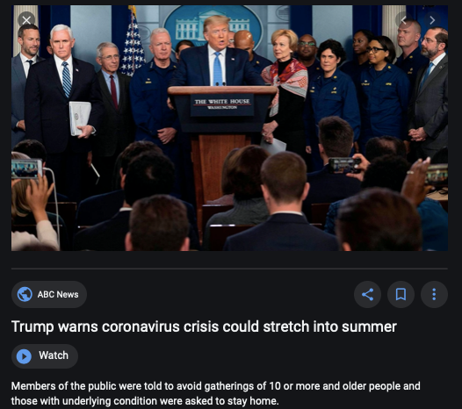
Coronavirus!

Slide 25
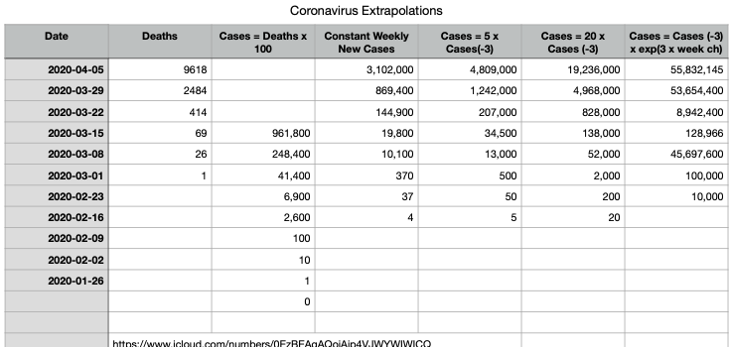
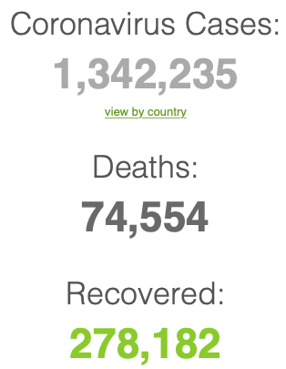
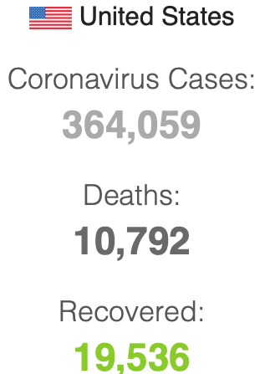

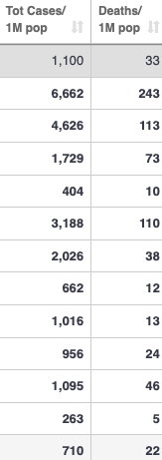
Coronavirus
Where we think we are, as of Mo Apr 6:
We really do not know
No random samples…
Best thing I have read comes from Jim Stock <https://drive.google.com/file/d/12MV466ZZy5xHir4xdPhoTrL1oO8CbZU-/view>:
The basic SIR epidemiological model of contagion
The effect of social distancing and business shutdowns on epidemic dynamics enters the model through a single parameter: the case transmission rate β
Re-express the model in terms of β and the asymptomatic (or not very symptomatic) hence non-tested rate—the fraction of the infected who are not tested
The COVID-19 non-testing rate is unidentified in our model
Estimates in the epidemiological literature range from 0.18 to 0.86.
The asymptomatic rate could be estimated accurately and quickly by testing a random sample
The optimal policy response and its economic consequences hinge critically on the asymptomatic rate

Slide 26
Where we think we are, as of Mo Apr 6:
We really do not know
No random samples…
Best thing I have read comes from Jim Stock <https://drive.google.com/file/d/12MV466ZZy5xHir4xdPhoTrL1oO8CbZU-/view>:
The basic SIR epidemiological model of contagion
The effect of social distancing and business shutdowns on epidemic dynamics enters the model through a single parameter: the case transmission rate β
Re-express the model in terms of β and the asymptomatic (or not very symptomatic) hence non-tested rate—the fraction of the infected who are not tested
The COVID-19 non-testing rate is unidentified in our model
Estimates in the epidemiological literature range from 0.18 to 0.86.
The asymptomatic rate could be estimated accurately and quickly by testing a random sample
The optimal policy response and its economic consequences hinge critically on the asymptomatic rate

Slide 30

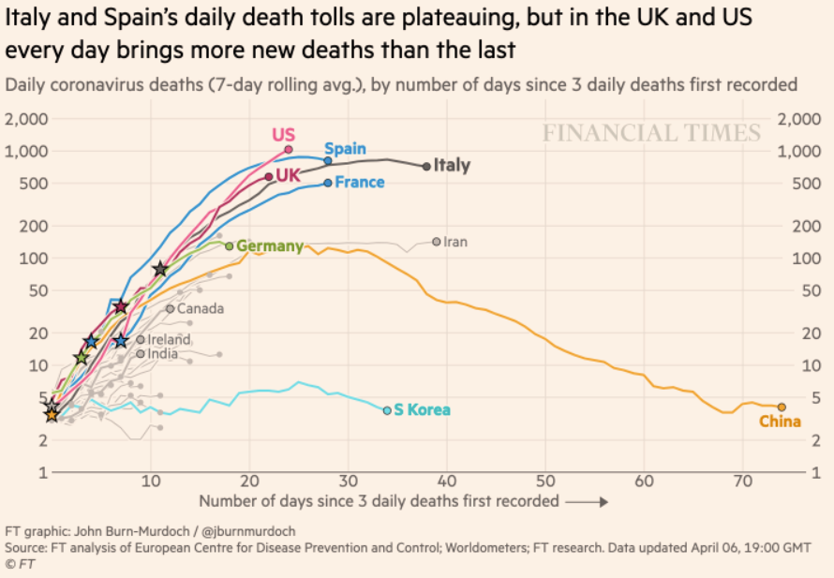
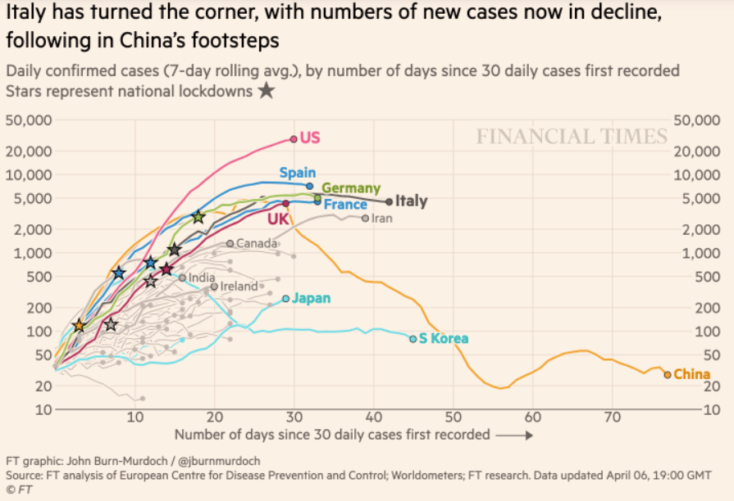
Financial Times Graphs Blown Up…

Slide 34



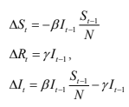
James Stock (2020)
Standard SIR model:<https://drive.google.com/file/d/12MV466ZZy5xHir4xdPhoTrL1oO8CbZU-/view>:
Susceptible, Infected, Recovered (& immune), transmission rate β, recovery rate γ, reproduction number R0, asymptomatic hence non-tested rate π0
Calibration: half-life of infection one week: γ = 0.5, s0 = 0.02, 50 cases on Jan 24
For March 21, 2020, the positive test rate in the United States is approximately 10%…
<https://drive.google.com/file/d/12MV466ZZy5xHir4xdPhoTrL1oO8CbZU-/view>

Slide 39
Bringing the Economy Back Up from Anæsthesia
Major issues:
Certificates of immunity:
Which requires test, test, test:
And not just disease virus tests
Presence-of-antibodies tests
How quickly can we match the immune with public-contact jobs?
What jobs can be done with minimal infection risk?
What minimal-infection substitutes can we find for previous jobs?
How quickly can restrictions be relaxed without the virus coming roaring back?
How do we avoid having the market give a “shutdown” signal to enterprises we in fact want restarted?
Which is pretty much all of them
How much of the potential caseload do we want to push out beyond the vaccine-arrival date?
ALL THESE QUESTIONS ARE ANSWERABLE IF WE LEARN THE ASYMPTOMATIC HENCE NON-TESTED RATE!!

Slide 40
Keeping the Economy from Crashing During the Lockdown
Nick Rowe: We have a 50% output cut in 100% of the sectors:
A temporary 100% output cut in 50% of the sectors (what the Coronavirus does) is very different from a 50% output cut in 100% of the sectors
Nick’s thought experiment:
In three months we are going to invent unobtanium:
Substantial intertemporal substitutibility
Plus lower cross-good contemporaneous substitutitbility
Hence high desired savings rate now
Flex-price market thus produces a nominal rate at the zero lower bound and a high inflation rate over the next three to six months
Plus liquidity-constrained workers in affected sectors see their demand go to zero immediately
Can we get there? Should we get there? What should we do instead?
We need a good RBC economist: are there any?…
<https://worthwhile.typepad.com/worthwhile_canadian_initi/2020/03/relative-supply-shocks-unobtainium-walras-law-and-the-coronavirus.html>

Slide 41
Keeping the Economy from Crashing During the Lockdown II
Nick Rowe <https://worthwhile.typepad.com/worthwhile_canadian_initi/2020/03/relative-supply-shocks-unobtainium-walras-law-and-the-coronavirus.html>:
Plus: to extend the thought experiment:
We just lost the ability to make “unobtainium”
So we should be substituting leisure for work, and moving workers into relatively unproductive labor, making the commodities we can still produce right now
How should relative prices move as a result? How should we make them move?
Plus: distributional issues
Plus: bankruptcy and credit chain issues

Slide 42

MOAR Coronavirus!
Death for Geezers!
Mortality for the Youngs very low…
It’s the flu for them—for you…
And an extra doubling—or is it 5%?—mortality for the asthmatic
And an extra doubling—or is it 5%?—mortality for the overweight

Slide 43
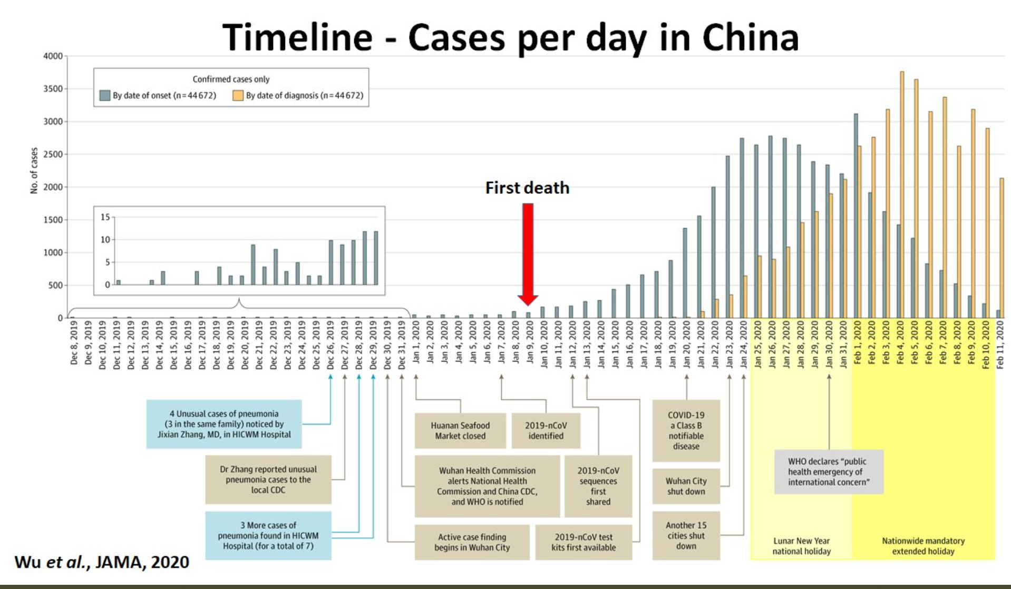
What We Think Happened in Wuhan
China beat it quickly & relatively easily!
We think
Shut down Wuhan when 200 cases per day
That seems to have been a good decision

Slide 44

The Goal
When Is It Appropriate to Move on This?
Immediate social distancing…
Self-isolate if you have a cough and a fever…
Hope that warmer temperatures will do to this what they did to SARS…
Otherwise, when do you want to start spreading out transmission. It seems that early is as good as later, so do it early…
I have no good intuition on why you want to move early
Plus your moving early will be wasted if you get reinfected
Plus the sparks you throw off making others’ lives more difficult

Slide 45
References
Financial Times (2020): Coronavirus Tracked: The Latest Figures as the Pandemic Spreads <https://www.ft.com/coronavirus-latest>
Nick Rowe (2020): Relative Supply Shocks, Unobtainium, Walras' Law, and the Coronavirus <https://worthwhile.typepad.com/worthwhile_canadian_initi/2020/03/relative-supply-shocks-unobtainium-walras-law-and-the-coronavirus.html>
Jim Stock (2020): Coronavirus Data Gaps and the Policy Response <https://drive.google.com/file/d/12MV466ZZy5xHir4xdPhoTrL1oO8CbZU-/view>

Slide 46
MOAR Coronavirus!
What I am watching:
Max Roser & Hannah Ritchie: Coronavirus Disease (COVID-19) <https://ourworldindata.org/coronavirus>…
Worldometer: Coronavirus Update (Live) <https://www.worldometers.info/coronavirus/>: ‘125,599 Cases and 4,605 Deaths from COVID-19 Virus Outbreak…
FT Coronavirus Tracker <https://www.ft.com/content/a26fbf7e-48f8-11ea-aeb3-955839e06441>
Josh Marshall’s COVID Twitter List <https://twitter.com/i/lists/1233998285779632128>
NEJM Group: Updates on the Covid-19 Pandemic <http://m.n.nejm.org/nl/jsp/m.jsp?c=%40kxNtXckRDOq8oG0jJvAXsIzN4mPECIPhltxoTSdTU9k%3D&cid=DM89089_NEJM_COVID-19_Newsletter&bid=173498255>: 'From the New England Journal of Medicine, NEJM Journal Watch, NEJM Catalyst, and other trusted sources...

Slide 47
Catch Our Breath…
Ask a couple of questions?
Make a couple of comments?
Any more readings to recommend?
<https://www.icloud.com/keynote/0YKEi7HeOrVGvKYtt9FEqH7nA>

Slide 48
Coronavirus! (March 16)
With 31 deaths in the U.S. as of March 11, a 1% death rate, and up to 4 weeks between infection and death, that means that as of Feb 12 there were 3100 coronavirus cases in the United States.
With 87 deaths in the U.S. as of Mar 16, a 1% death rate, and up to 4 weeks between infection and death, that means that as of Feb 17 there were 8700 coronavirus cases in the United States
If it is doubling every seven days, then now about 150,000 people have and in the next week about 150,000 more people in the U.S. will catch coronavirus—which means 1/2200, currently 3500 of the 7.6 million inhabitants of San Francisco Bay. Touch a hard surface that any of those 3500 has touched in the last 48 hours, and the virus has a chance to jump to you…
These numbers could be five times too big. These numbers are probably not five times too small unless the thing is a lot less deadly, and there are a lot of asymptomatic cases…
What is wrong with this analysis?

Slide 49

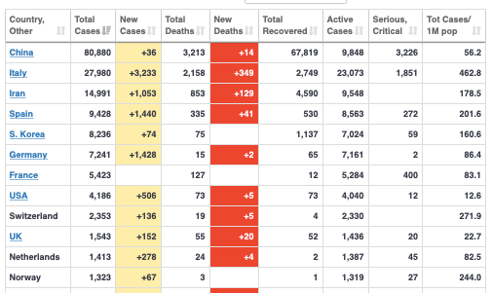
MOAR Coronavirus!
As of March 21: Things are not moving in the right direction:
What is the R0?
How can the R0 be changed?
How will the R0 change?
What is the asymptote share of the population?
What is the mortality rate?

Slide 50

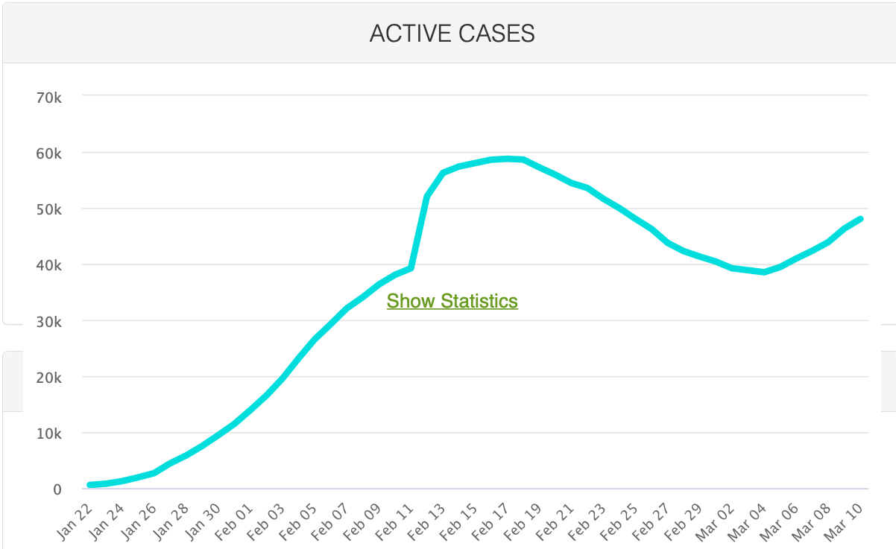
MOAR Coronavirus!
As of March 10: Things are not moving in the right direction:
What is the R0?
How can the R0 be changed?
How will the R0 change?
What is the asymptote share of the population?
What is the mortality rate?

Slide 51
Notes

Slide 52
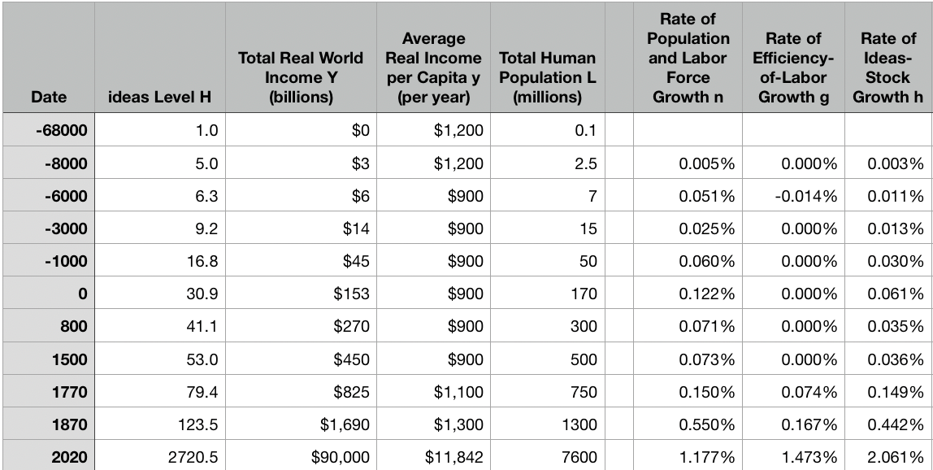
Reviews
Post-1870 is the miracle:

Slide 53
Review: The Broad Sweep
Post-1870 is the miracle:

Slide 54
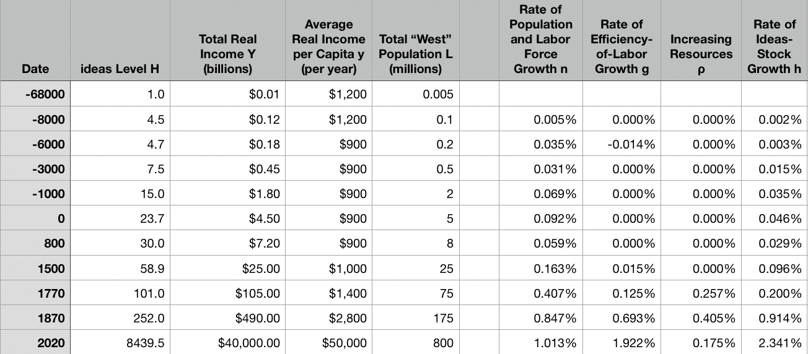
“The West”
800, 1500, 1770, or 1870?:

Slide 55
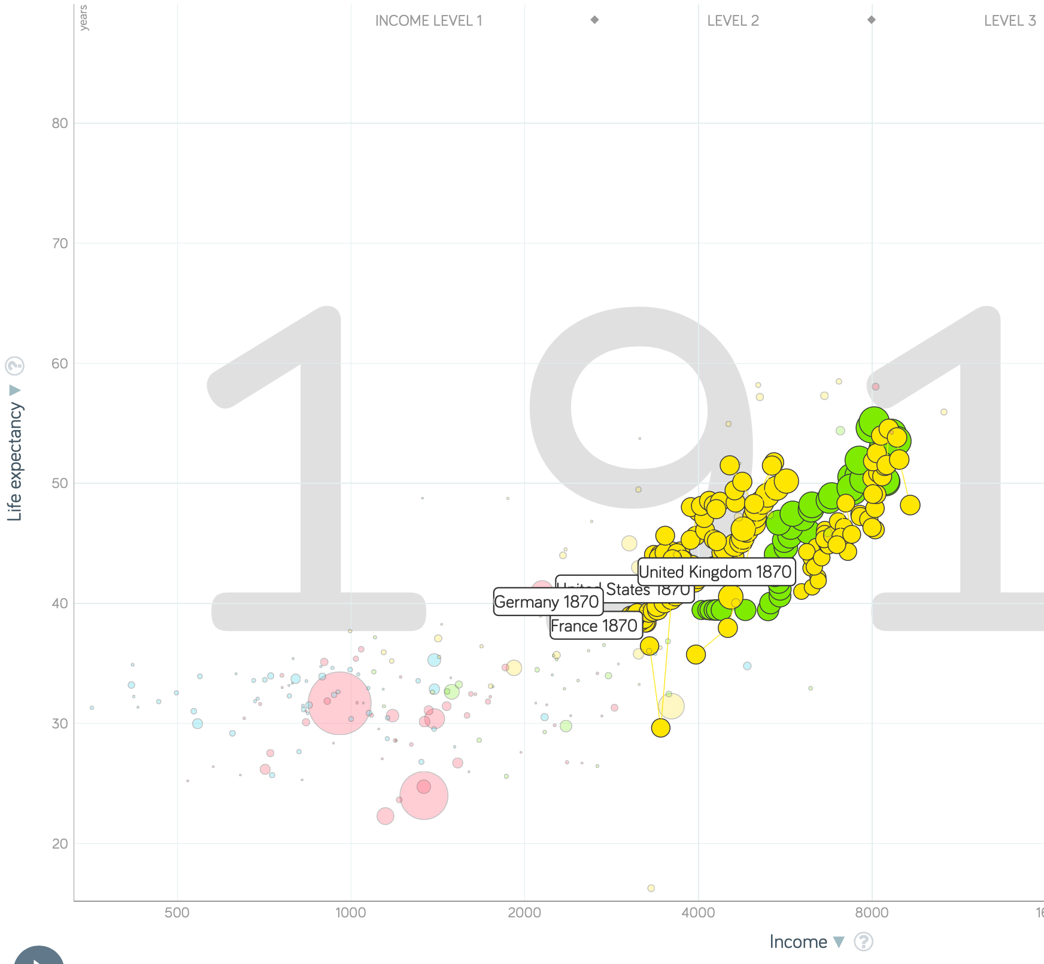
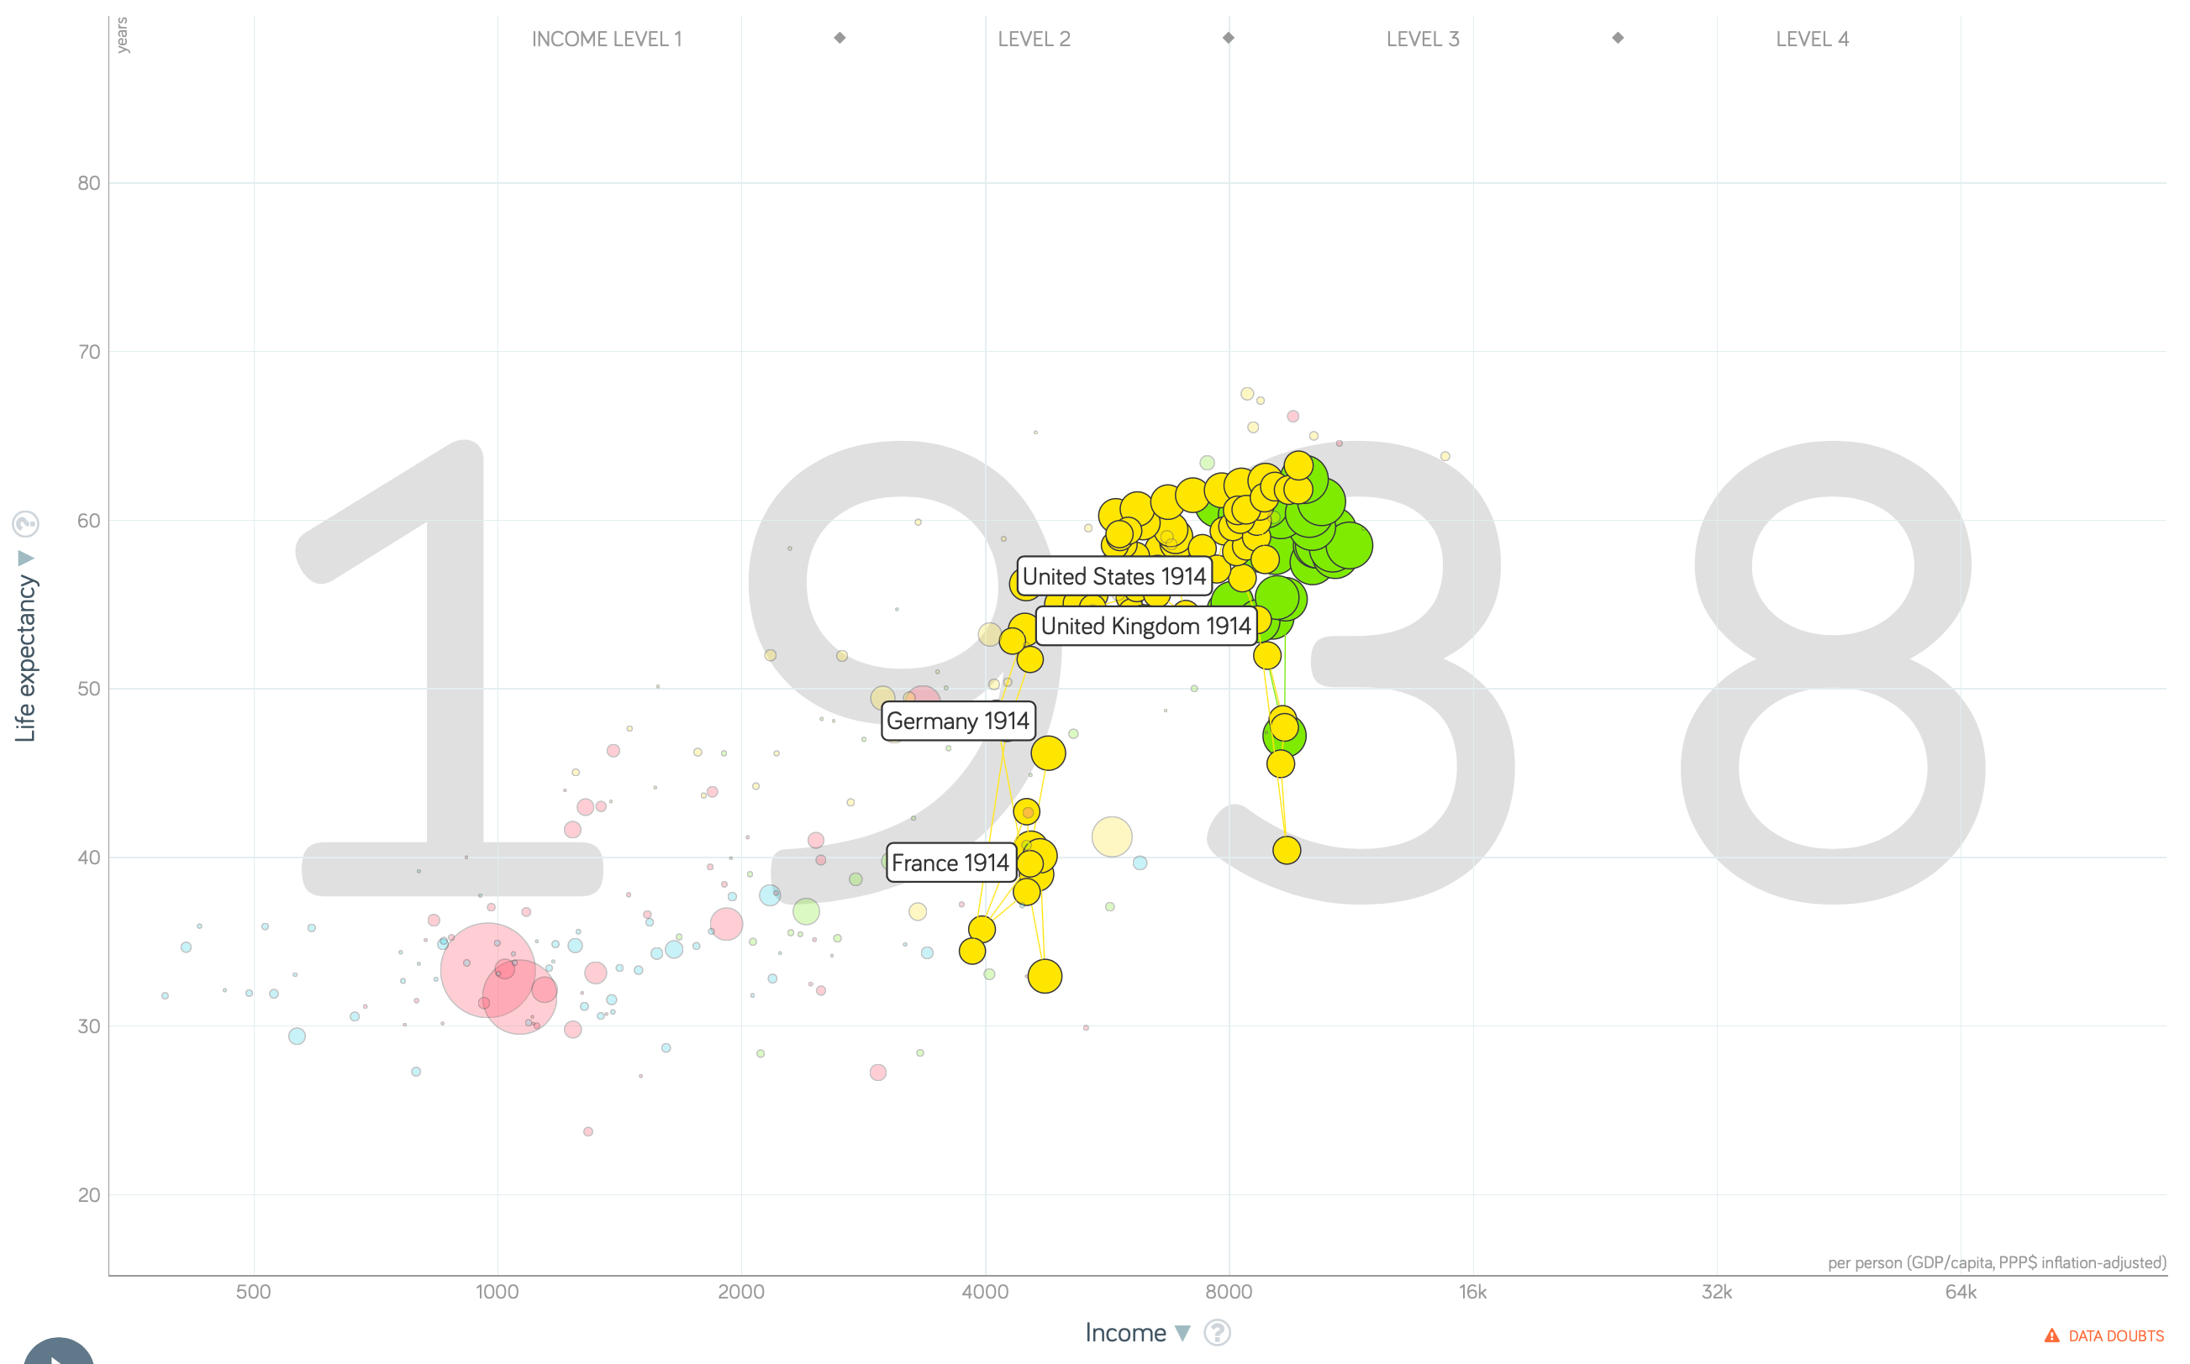
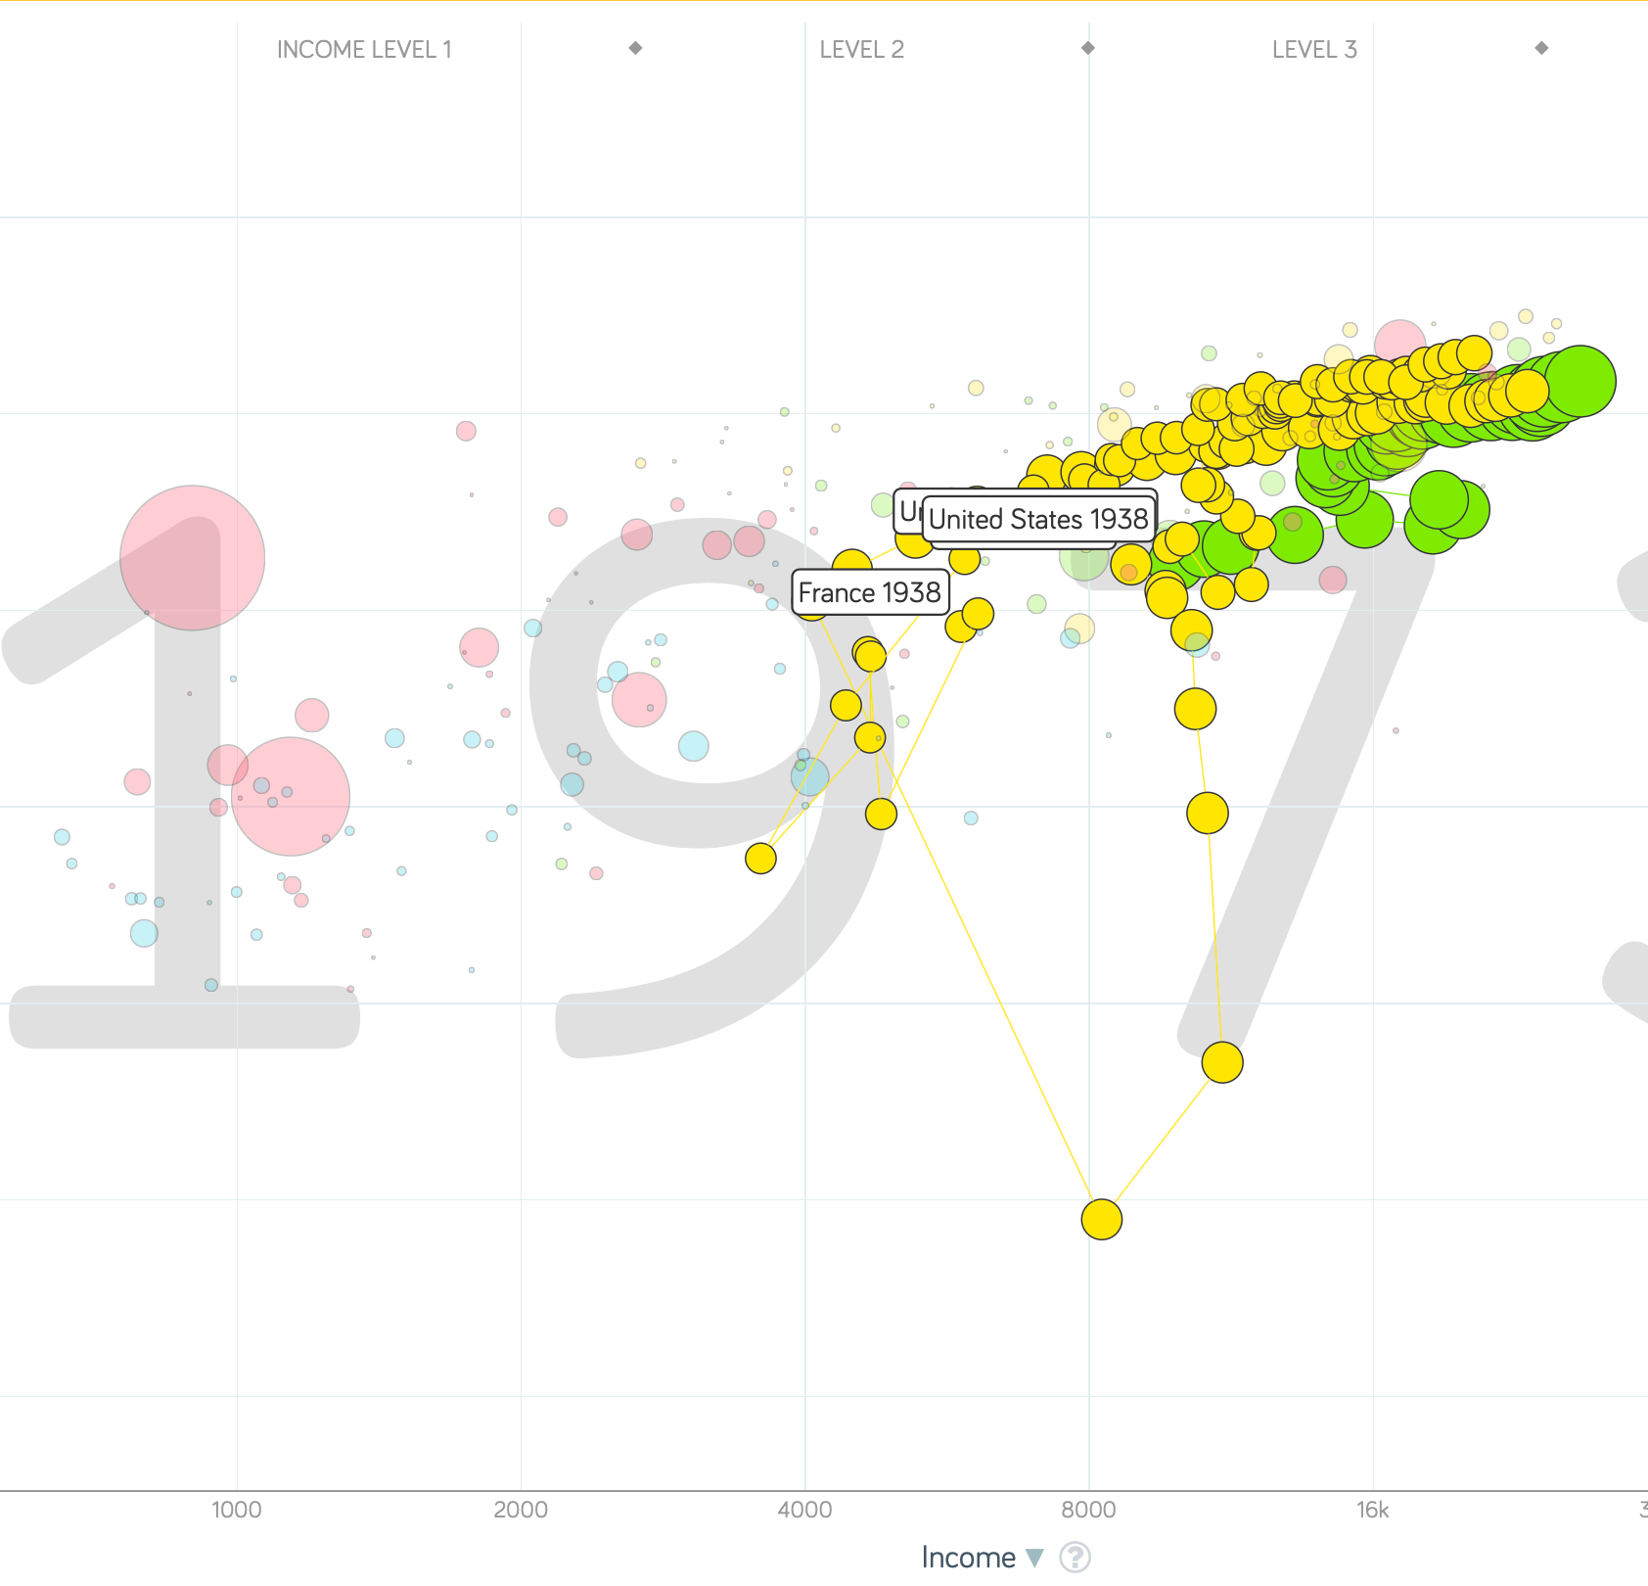
“The West”
1914-1938, 1870-1913, & 1938-1973
Rate of growth in the North Atlantic industrial core halves comparing 1870-1913 to 1914-1938; then triples afterwards over 1938-1973
Slows again after 1973

Slide 56
To Your iClickers
What was the growth rate of ideas in the industrial core of the world economy over 1870-2020?
About 2.3%/year
About 0.9%/year
About 0.23%/year
About 4%/year
None of the above

Slide 57
To Your iClickers
What was the growth rate of ideas in the industrial core of the world economy over 1770-1870?
About 2.3%/year
About 0.9%/year
About 0.23%/year
About 4%/year
None of the above

Slide 58
Review: The Belle Époque Broken
John Maynard Keynes:
“Very few of us realise[d] with conviction the intensely unusual, unstable, complicated, unreliable, temporary nature of the economic organisation by which Western Europe has lived for the last half century. We assume some of the most peculiar and temporary of our late advantages as natural, permanent, and to be depended on, and we lay our plans accordingly.
“On this sandy and false foundation we scheme for social improvement and dress our political platforms, pursue our animosities and particular ambitions, and feel ourselves with enough margin in hand to foster, not assuage, civil conflict in the European family....
“France, Germany, Italy, Austria, and Holland, Russia and Roumania and Poland, throb together, and their structure and civilisation are essentially one. They flourished together, they have rocked together in a war which we, in spite of our enormous contributions and sacrifices (like though in a less degree than America), economically stood outside, and they may fall together…”

Slide 59
Aristocracy & Social Democracy
The aristocrats had rolled the dice:
Europe in 1914 was a Europe of national populations, of industrialists and socialists, of factory workers and technicians…
Europe’s governments in 1914—especially the defense and foreign affairs ministries—had been populated by aristocrats, ex-aristocrats, and would-be aristocrats.
Landed, aristocratic, military elites had control of many of the levers of propaganda and power…
Aristocrats had had help. Industrialists and entrepreneurs were eager to provide their political support in return for economic benefits, as in the 1879 German “marriage of iron and rye”: the imposition of tariffs on imports of British steel (to protect the positions of German manufacturers) and on imports of American grain (to protect the positions of German landlords)…
On the eve of World War I, these landed military service aristocrats, ex-aristocrats, and would-be aristocrats increasingly found themselves members of a social caste that had no societal function…
But power—in the form of office and of vast (if declining relative) wealth—and propaganda—in the form of pageantry and the press—were reinforced by ideologies: Social darwinism…
The aristocrats rolled the dice—and lost…
Social democrats picked up the chips:
Expanded suffrage…
Proportional representation…
“Lands fit for heroes…”
How to provide for the benefits politicians promised?

Slide 60
Reparations, Taxes, and Inflation
Reparations
A peace “without annexations and indemnities”…
But not without reparations…
Two years’ of Germany’s national income demanded:
Much of it “boob bait for the bubbas…” on the part of Allied politicians…
But a powerful shaper of post-WWI Germany
Taxes
High and progressive tax rates…
A powerful impact on inequality…
Class war…
Inflation
U.S.: price level x1.5
Britain: price level x2.0
France: price level x7.0
French government had encouraged investment in Russian bonds…
German: price level x1,000,000,000,000
Austria, Hungary, Czechoslovakia the same…

Slide 61
Keynes’s Protest
Jan Christian Smuts:
“Poor Keynes often sits with me at night after a good dinner and we rail against the world and the coming flood. And I tell him that this is the time for Grigua’s prayer (the Lord to come himself and not to send his Son, as this is not a time for children). And then we laugh, and behind the laughter is [Herbert] Hoover’s horrible picture of thirty million people who must die unless there is some great intervention. But then again we think that things are never really as bad as that; and something will turn up, and the worst will never be. And somehow all these phases of feeling are true and right in some sense…”

Slide 62
Keynes’s Protest II
John Maynard Keynes:
“If we aim deliberately at the impoverishment of Central Europe, vengeance, I dare predict, will not limp. Nothing can then delay for long that final civil war between the forces of reaction and the despairing convulsions of revolution, before which the horrors of the late German war will fade into nothing, and which will destroy... the civilization and progress of our generation…”

Slide 63
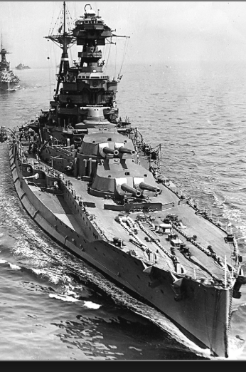
Review: World War I
Nationalism
Max Weber: “The vulgar conception of political economy is that it consists in working out recipes for making the world happy.… However… elbow-room… can [only] be won… through the hard struggle.... That standard of value adopted by a German economic theorist, can… be nothing other than a German policy and a German standard.... Our successors will... hold us responsible... for the amount of elbow-room we conquer.... The science of political economy is... a servant of... the lasting political-power interests of... our nation's power, and the vehicle of that power, the German national state…”
Erich von Manstein: von Manstein, von Lewinsky, Lewinski, Levi…
“We offered 4 battleships a year, the navy demanded 6, and we compromised at 8”

Slide 64
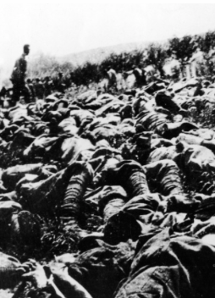
The Catastrophe of World War I: Origins
In the summer of 1914 the empires of Russia and Austria-Hungary are skirmishing diplomatically and threatening each other militarily about the latest Balkan crisis
Began when in the summer of 1914 the Archduke Franz Ferdinand and his wife Sophie were assassinated in Sarajevo
By terrorists with very close links to the intelligence service of the Kingdom of Serbia
What would Austria’s response be?
And then Germany attacks Belgium
And then Australia attacks Turkey

Slide 65
The Catastrophe of World War I: Causes
Why?: “If there is a war, let it come now…”
Russia thought it would have to fight Germany someday, and might as well while France was interested…
Austria, France, Britain (as a result of the German battle fleet) the same
“Busy giddy minds with foreign quarrels…”
A wiser man: Otto von Bismarck:
“There is nothing in the Balkans worth the bones of a single Pomeranian grenadier…”

Slide 66
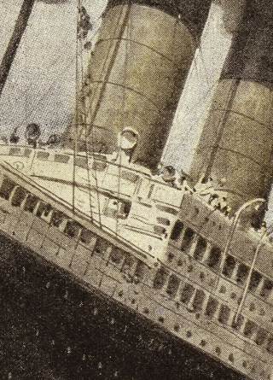
How Does the U.S. Get Involved?
British policy: binding the U.S. upper class to Britain since the 1840s
The Law of the Sea
Neutrals
Blockade
The submarine
Unrestricted submarine warfare
Zimmerman Telegram
Woodrow Wilson
“Teach the Mexicans to elect good men…”
“The war to end war…”

Slide 67
The Catastrophe of World War I: Outcome—Human
Combatants had mobilized 65M out of 100M men of military age
10M killed
10M maimed
Civilian casualties less than 10% of military
Costs of 1.5x a year’s GDP
Plus a 15M global flu epidemic
Russian, Austro-Hungarian, German, Ottoman Turkish Empires all gone…
Representative governments destabilized—or weak…
The Russian Revolution…
Hungarian, Bavarian socialist republics (short-lived)
Spartakist…
Allies demand 2 years of German GDP as “reparations”…

Slide 68
Catch Our Breath…
Comments?
Questions?

Slide 69

Review: Edward Bellamy: Looking Backward
Edward Bellamy: Looking Backward <https://delong.typepad.com/files/bellamy-backward.pdf>: Perhaps the third best-selling novel of the 19th century in the United States
2000 is a utopia…
The narrator is carried forward in time from 1887-2000 by an implausible plot device:
‘“This is the tenth day of September in the year 2000, and you have slept exactly one hundred and thirteen years, three months, and eleven days…”’
He then wanders around, looking at the utopia of 2000…
The opening:
‘“How could I live without service to the world?” you ask…. The answer is that my great-grandfather had accumulated a sum of money on which his descendants had ever since…. The sum had been originally by no means large. It was, in fact, much larger now that three generations had been supported upon it in idleness, than it was at first…’

Slide 70
The Stagecoach of Society
Those who ride and this who pull:
‘Commiseration was frequently expressed by those who rode for those who had to pull the coach, especially when the vehicle came to a bad place in the road, as it was constantly doing, or to a particularly steep hill. At such times, the desperate straining of the team, their agonized leaping and plunging under the pitiless lashing of hunger, the many who fainted at the rope and were trampled in the mire, made a very distressing spectacle, which often called forth highly creditable displays of feeling on the top of the coach.
‘At such times the passengers would call down encouragingly to the toilers of the rope, exhorting them to patience, and holding out hopes of possible compensation in another world for the hardness of their lot, while others contributed to buy salves and liniments for the crippled and injured. It was agreed that it was a great pity that the coach should be so hard to pull, and there was a sense of general relief when the specially bad piece of road was gotten over. This relief was not, indeed, wholly on account of the team, for there was always some danger at these bad places of a general overturn in which all would lose their seats.
‘It must in truth be admitted that the main effect of the spectacle of the misery of the toilers at the rope was to enhance the passengers’ sense of the value of their seats upon the coach, and to cause them to hold on to them more desperately than before…

Slide 71
The Stagecoach of Society II
“Finer clay”:
‘The other fact is yet more curious, consisting in a singular hallucination which those on the top of the coach generally shared, that they were not exactly like their brothers and sisters who pulled at the rope, but of finer clay, in some way belonging to a higher order of beings who might justly expect to be drawn. This seems unaccountable, but, as I once rode on this very coach and shared that very hallucination, I ought to be believed.
‘The strangest thing about the hallucination was that those who had but just climbed up from the ground, before they had outgrown the marks of the rope upon their hands, began to fall under its influence. As for those whose parents and grand-parents before them had been so fortunate as to keep their seats on the top, the conviction they cherished of the essential difference between their sort of humanity and the common article was absolute. The effect of such a delusion in moderating fellow feeling for the sufferings of the mass of men into a distant and philosophical compassion is obvious.
‘To it I refer as the only extenuation I can offer for the indifference which, at the period I write of, marked my own attitude toward the misery of my brothers…

Slide 72
The Stagecoach of Society III
Class war:
‘The sanguine argued very forcibly that it was in the very nature of things impossible that the new hopes of the workingmen could be satisfied, simply because the world had not the wherewithal to satisfy them. It was only because the masses worked very hard and lived on short commons that the race did not starve outright, and no considerable improvement in their condition was possible while the world, as a whole, remained so poor.
‘It was not the capitalists whom the laboring men were contending with, these maintained, but the iron-bound environment of humanity, and it was merely a question of the thickness of their skulls when they would discover the fact and make up their minds to endure what they could not cure.
The less sanguine admitted all this. Of course the workingmen’s aspirations were impossible of fulfillment for natural reasons, but there were grounds to fear that they would not discover this fact until they had made a sad mess of society. They had the votes and the power to do so if they pleased, and their leaders meant they should. Some of these desponding observers went so far as to predict an impending social cataclysm. Humanity, they argued, having climbed to the top round of the ladder of civilization, was about to take a header into chaos…’

Slide 73
The Limit of Human Felicity I
In the music room:
‘She made me sit down comfortably, and, crossing the room, so far as I could see, merely touched one or two screws, and at once the room was filled with the music of a grand organ anthem; filled, not flooded, for, by some means, the volume of melody had been per- fectly graduated to the size of the apartment. I listened, scarcely breathing, to the close. Such music, so perfectly rendered, I had never expected to hear.
‘“Grand!” I cried, as the last great wave of sound broke and ebbed away into silence. “Bach must be at the keys of that organ; but where is the organ?”…
‘“There are a number of music rooms in the city, perfectly adapted acoustically to the different sorts of music. These halls are connected by telephone with all the houses of the city…. Any one of the four pieces now going on that you prefer, you can hear by merely pressing the button which will connect your house-wire with the hall where it is being rendered…”’

Slide 74
The Limit of Human Felicity III
Four live orchestras you can listen to on the speakerphone!
‘“It appears to me, Miss Leete,” I said, “that if we could have devised an arrangement for providing everybody with music in their homes, perfect in quality, unlimited in quantity, suited to every mood, and beginning and ceasing at will, we should have considered the limit of human felicity already attained, and ceased to strive for further improvements…”’

Slide 75
Review: The View from 3000: Themes & Big Ideas
Science reaches critical mass and from it springs engineering—all of the engineering subdisciplines, including the management of human resources and of organizations. From a liberal political order spring national and then the global market economy. And from engineering and the market, and the large bureaucratic corporation then, over the course of 1870-2016, spring…
History was economic…
Explosion of wealth…
Cornucopia of technology…
Demographic transition…
Feminist revolution…
Inclusion and hierarchy attenuation…
Empowered tyrannies…
Wealth gulfs…
Mismanagement and insecurity…

Slide 76
Measuring Growth
What are my estimates of the rate of growth of economically-useful human knowledge over 1-1500, 1500-1800, 1800-1870, and 1870-2000?
0.02%/year, 0.2%/year, 0.5%/year, and 0.8%/year
0.000%/year, 0.02%/year, 0.2%/year, and 0.8%/year
0.02%/year, 0.2%/year, 0.8%/year, and 2.3%/year
0.2%/year, 0.8%/year, 2.3%/year, and 4.7%/year
None of the above.

Slide 77
What Is the Key Factor in the Explosion of Wealth in the 20th Century?
Yes, many things contributed. But suppose you have to pick just one

Slide 78
What Are the Four Factors That I See as Making for the Explosion of Wealth in the 20th Century?
Yes, there are many, many more things that contributed. But suppose you have to pick just four:

Slide 79
Demography II
What is the principal cause of the demographic transition?
Female wealth and control of property.
Female literacy.
Falling infant and child mortality.
Land shortages and high unemployment.
Something else.

Slide 80
Feminism
How many pregnancies do we think Abigail Smith Adams had between when she was 20 and 34?
2.
4.
6.
8.
18.

Slide 81
Empowered Tyrannies II
How many world leaders are members of the 10-million club?
2.
4.
6.
8.
18.

Slide 82
Inclusion and Hierarchy Attenuation
At the start of the 1970s, future President Ronald Reagan said that diplomats from Tanzania appeared uncomfortable:
resisting pressure to vote with the Soviet Union at the United Nations.
making small talk with New York socialites.
wearing shoes.
in formal tuxedos.
None of the above.

Slide 83
Economic Mismanagement and Insecurity II
According to Karl Polanyi, what rights does the market economy respect?
rights to land (a stable community).
rights to labor (a “just” income).
rights to finance (a stable economic place).
rights to property (the ability to keep what you manage to claim to earn).
None of the above.

Slide 84
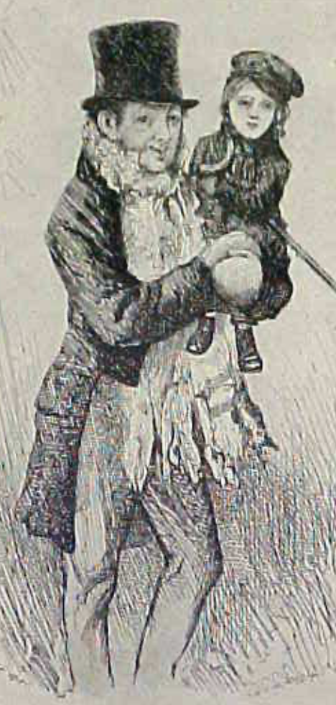
Review: The Watershed: 1870 as an Inflection Point
As of 1870, had the Industrial Revolution raised the standard of living or lightened the toil of the working class in England, the country at its center?
Yes
No
It’s not clear
Why? Malthusian forces—population explosion & thus smaller farm sizes. Growth, the growth had been slow 0.8%/year?

Slide 85
Globalization
Who called the era of globalization and growth from 1870 to 1914 an “economic El Dorado”?
Karl Marx
John Stuart Mill
Thomas Robert Malthus
John Maynard Keynes
None of the above
What would the others have said?

Slide 86
Migration
How many people of the roughly 1.5 billion then-population of the world left their continents of origin between 1870-1913?
10 million
50 million
100 million
200 million
400 million

Slide 87
Before 1870, Ideas Growth Not Fast Enough
And population growth accelerates as the world is not rich enough to undergo the demographic transition:
Value of useful and deployed ideas about technology and organization
-8000: 1
1: 3.5
1500: 4.75
1800: 9
1870: 16
2020: 421
Growth Rates:
-8000 to 1500: 0.02%/year
1500 to 1800: 0.2%/year
1800 to 1870: 0.8%/year
1870 to 2020: 2.3%/year
What caused these accelerations? What caused this last acceleration?

Slide 88
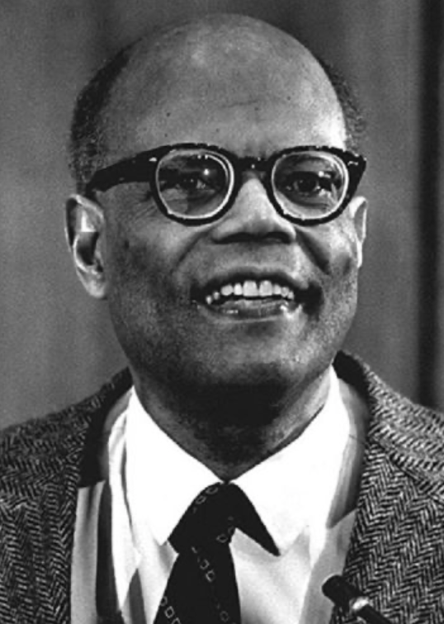
The Last Acceleration
The industrial research lab to routinize invention, and the modern corporation to routinize diffusion and deployment
Plus general purpose technologies—machine tools, non-human power sources
Arthur Lewis:
“New commodities: telephones, gramophones, typewriters, cameras, automobiles, and so on, a seemingly endless process whose latest twentieth-century additions include aeroplanes, radios, refrigerators, washing machines, television sets, and pleasure boats. Thus a rich man in 1870 did not possess anything that a rich man of 1770 had not possessed; he might have more or larger houses, more clothes, more pictures, more horses and carriages, or more furniture than say a school teacher possessed, but as likely as not his riches were displayed in the number of servants whom he employed rather than in his personal use of commodities…”
Not so much the particular technologies, as the grasping of the fact that there was a broad and deep range of new technologies to be discovered.
As much as it was new technologies, it was large-scale corporate organizations that could and did plan the division of labor to make use of and then market technologies.
And as much, it was that the global market meant that there was now a great deal of money to be made from the routinization of the exploration, development, and deployment of technological possibilities

Slide 89
Worldwide: The Broad Sweep
Post-1870 is the miracle:

Slide 90
“The West”
800, 1500, 1770, or 1870?:

Slide 91
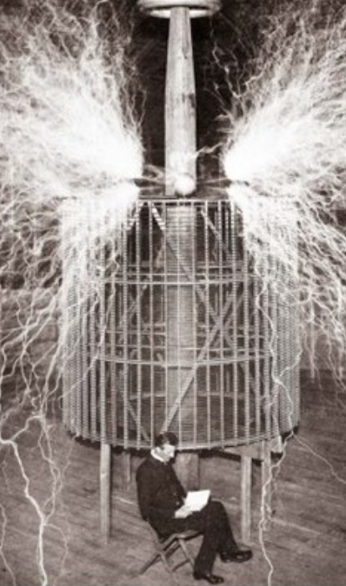
Who Is This Man?
And is he in any real danger?
Thomas Edison, and no
Andrew Carnegie, and no
Nicola Tesla, and no
Thomas Edison, and yes
Herbert Hoover, and yes

Slide 92
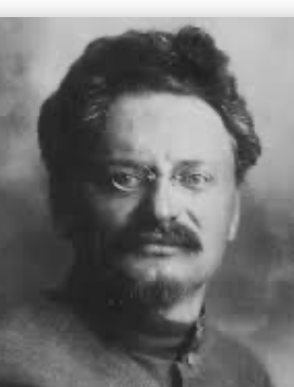
Lev Bronstein
Why did he say this?
“I had had no time to more than catch the general life-rhythm of the monster known as New York…”
“I left for Europe with the feeling of a man who has had only a peek into the furnace where the future is being forged…"

Slide 93
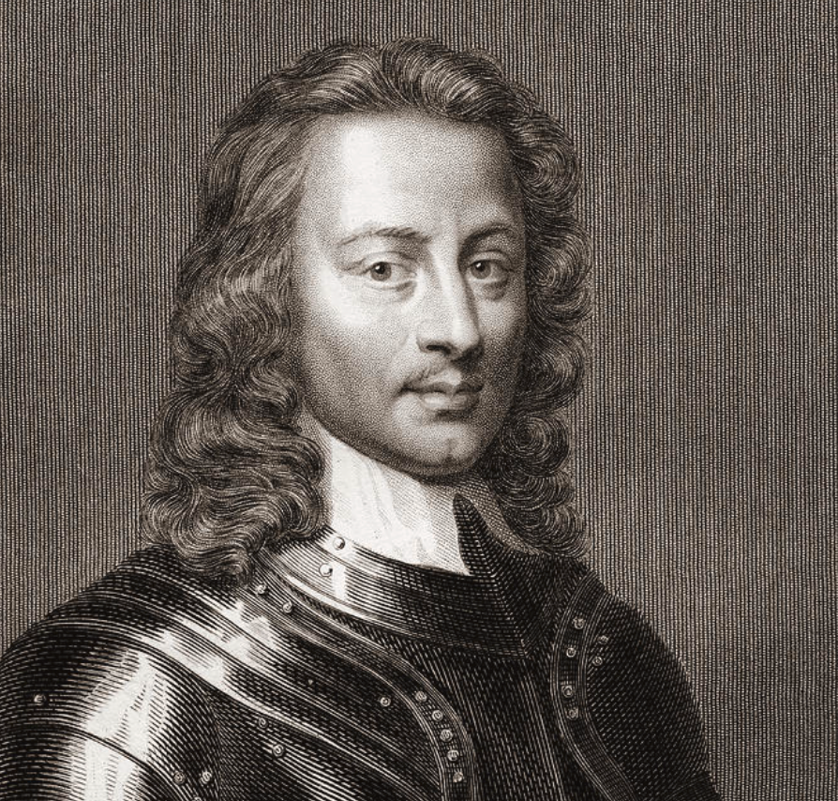
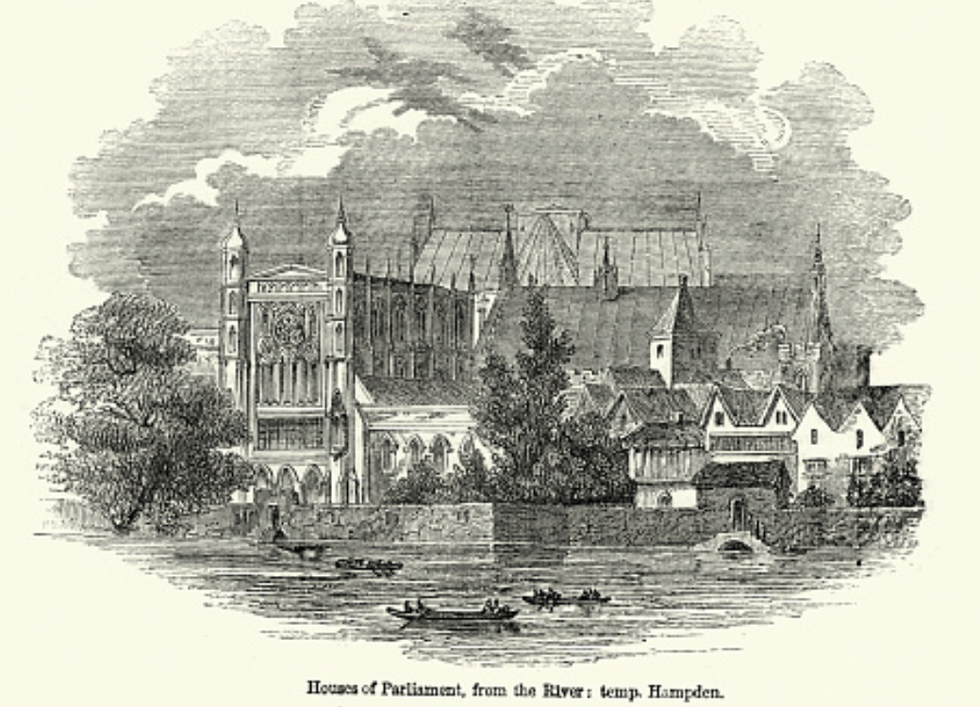
Review: Political Economy
From “Divine Right” and “Natural Order” to Enlightenment values…
Who was the first person to draft these words:?
“We hold these truths to be sacred & undeniable:
that all men are created equal & independant,
that from that equal creation they derive rights inherent & inalienable,
among which are the preservation of life, & liberty, & the pursuit of happiness;
that to secure these ends, governments are instituted among men, deriving their just powers from the consent of the governed…”
John Locke
Niccolo Machiavelli
Thomas Hobbes
Thomas Jefferson
George Washington
Why did he write them?

Slide 94
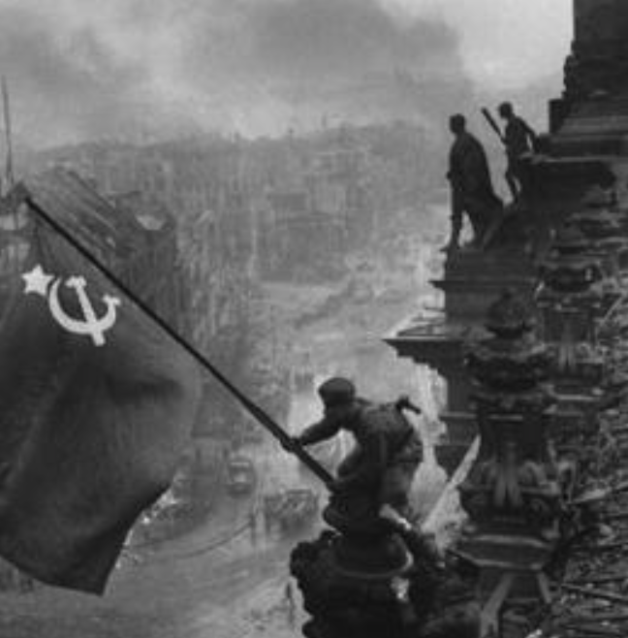
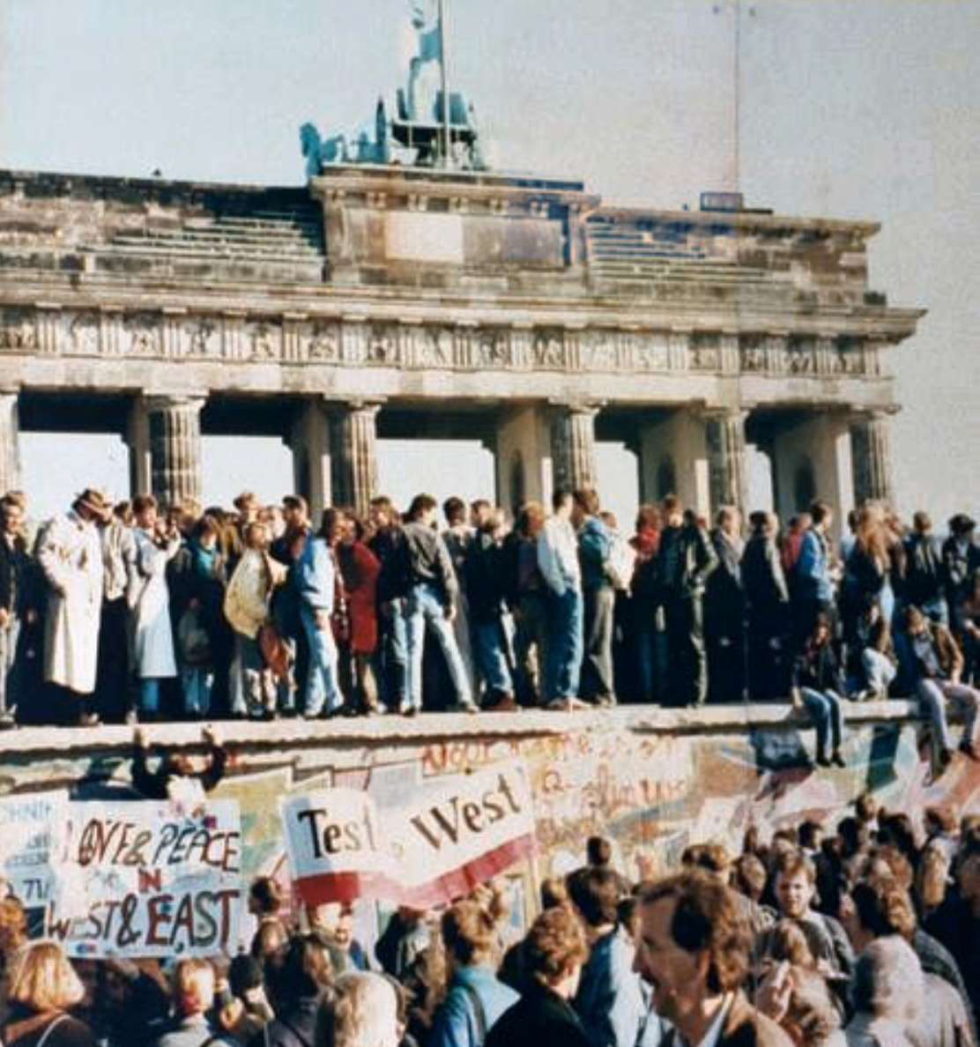
What Was the Proper Political Order?
Fears of “democracy” among American founders:
Madison: “Democracies have ever been spectacles of turbulence and contention... incompatible with personal security or the rights of property... as short in their lives as... violent in their deaths…”
Jefferson: “Gen’l Washington had not a firm confidence in the durability of our government… [& this] had some weight in his adoption of… ceremonies… calculated to prepare us gradually for a change which he believed possible…”
Hamilton: “the British government… best” as the only one “unit[ing] public strength with individual security…”
Adams: The American president should be announced as: “His Highness, the President of the United States, and Protector of the Rights of the Same…”
Question of political order thought settled: first in the rubble of Berlin in 1945, and then in the streets of East Germany in 1991:
Settled in favor of representative democracy, private property, & social insurance—late-1900s liberal democracy
But now reopened? Min Zhu (朱民) to me in 2015: “What are you Americans going to do to fix your broken political system?”

Slide 95
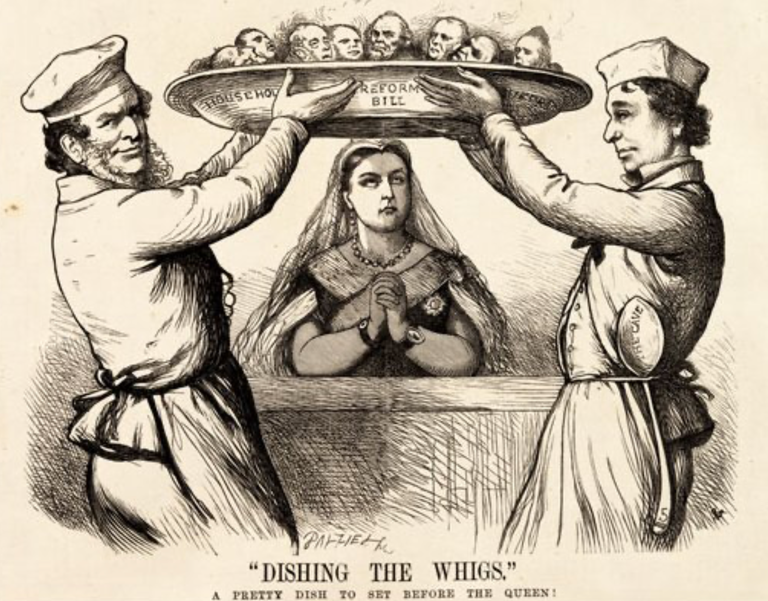
Franchise Restricted to the Rich Could Not Maintain Itself
The dynamic of franchise extension
Liberals in power would try extend on the principle that the new, poorer voters would be less conservative and would support them.
Threatening revolution would lead even conservatives to seek to extend the franchise in order to peel off of the revolutionary coalition those of the disenfranchised who had the most social power:
Earl Grey (yes, the tea): “The Principal… is to prevent… revolution…. I am reforming to preserve, not to overthrow…”
Charismatic leaders with popular followings would seek to give them votes, and then rule via plebiscites—going around the traditional elites
(Peculiar thing about Trump-Johnson: minority, and core is a minority of a minority…)
Conservatives: “dish the Whigs”—opportunities to form winning coalitions by appealing to those who were no profiting from the market economy, or felt that they were losing relative status in some ways…

Slide 96
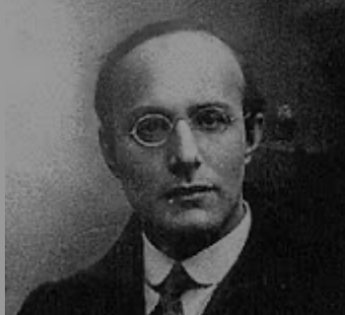
Popular Government and the Market Economy: Society’s Revenge
Karl Polanyi
People believe they have rights—to stable, supportive, nurturing communities; to incomes commensurate with their skills and status; and to money flows that will provide economic stability…
But a market society turns these things—land, labor, and finance—into commodities…
But they are not real commodities, they are fictitious commodities
And so you get your rights only if they satisfy a market profitability test
The only rights a market society respects are property rights:
& the only property rights that are worth anything are those that help you produce things for which rich people have a serious jones
Society will have its revenge: it will protect itself against the market logic, somehow, some way…

Slide 97
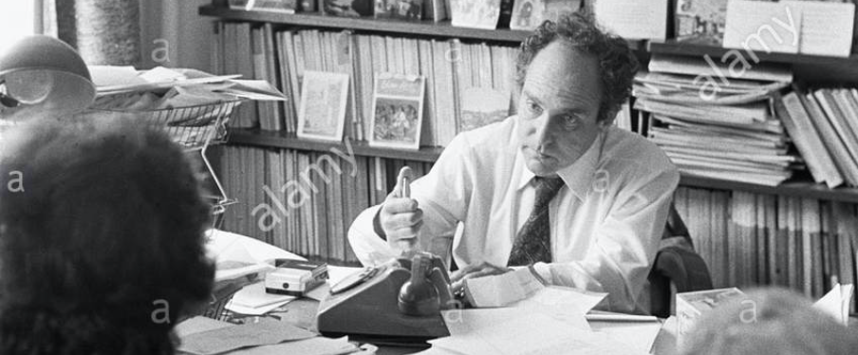
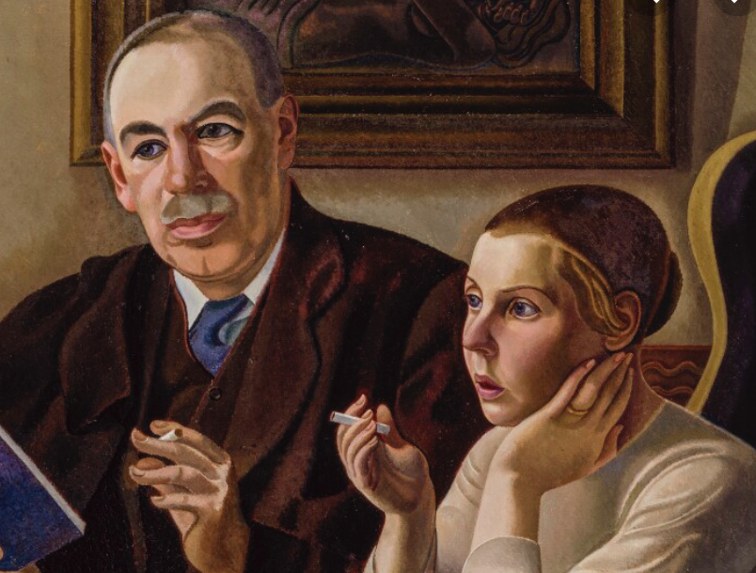

Digression: 5 Thinkers
Who shape my thought about the long 20th century—and how should, I think, shape yours
Beware! They are all deeply flawed…
But they are also geniuses, each in his way…
Beware of their followers! An iron law of ideology: a thinker’s most extravagant and aggressive followers will latch onto the stupidest and most shortsighted and wrong of their doctrines…
In historical order: Marx, Keynes, Hayek, Polanyi, Gellner
The other three thinkers:
Keynes: All that we need to produce general prosperity is technical adjustments to our system. Then the kingdom of freedom and prosperity will be within our grasp—and our major problems will no longer be economic ones
Gellner: The energy that most 19th century thinkers thought would go to “class“ went to “ethnos“ or “umma“ instead. The construction of ideological legitimations that makes sense both to dominants and to submissives who nevertheless believe they are part of some in-group is the key to understanding how societies stabilize themselves
Marx: Only the market economy will focus society’s energy on paying through the nose to boost the economy’s capital stock and to harvest the fruits of science and technology and then deploy them in production. But because the only demands in a market economy that matter are effective demands, the market economy also becomes a more “effective” means of slavery, for private property leads the proletariat to enslave themselves

Slide 98
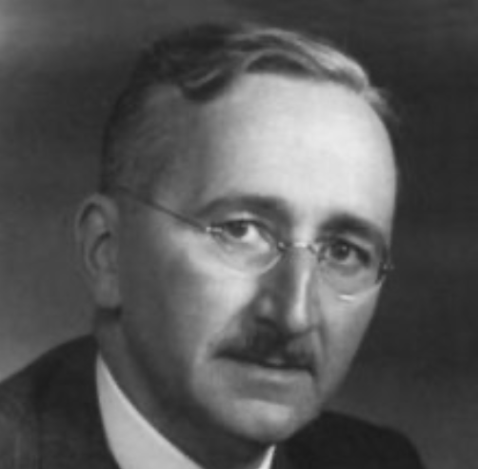
Hayek and Polanyi
Thumbnails on our first two:
Hayek:
Only the market economy can use society’s knowledge.
But the market economy cannot produce “social justice” and should not be asked to try—in fact, we need to recognize that all we can attain is freedom, and that will bring general prosperity, but that justice will be forever outside our reach
Polanyi:
The market economy turns land, labor, and finance into “fictitious commodities”
Society will have its revenge via a “double movement”

Slide 99
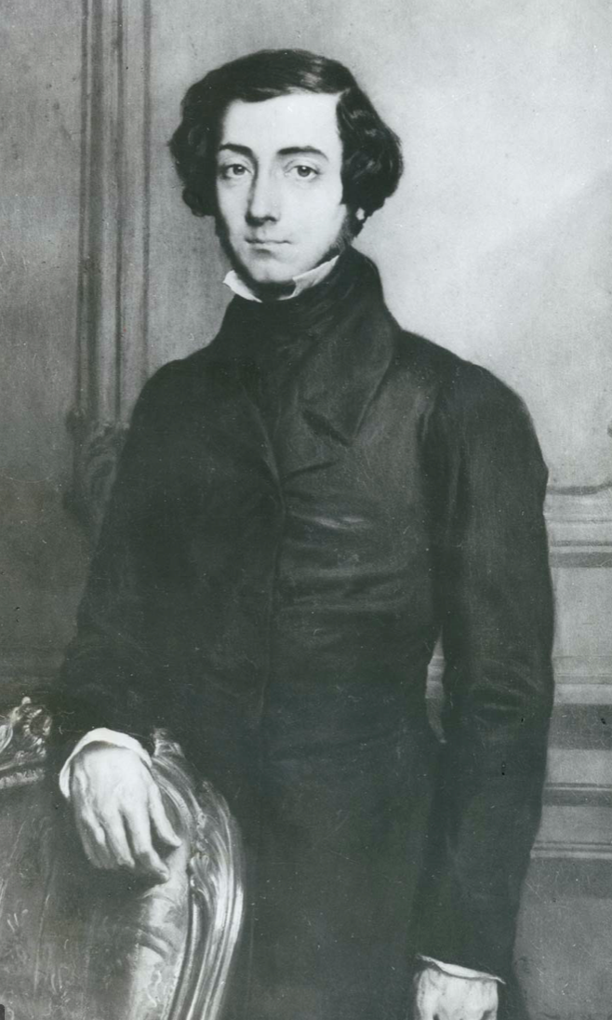
Plus Tocqueville
Toqueville on the rich as “elder brothers” in 1848:
“In the country all the landed proprietors, whatever their origin, antecedents, education or means, had come together, and seemed to form but one class: all former political hatred and rivalry of caste or fortune had disappeared from view. There was no more jealousy or pride displayed between the peasant and the squire, the nobleman and the commoner; instead, I found mutual confidence, reciprocal friendliness, and regard. Property had become, with all those who owned it, a sort of badge of fraternity. The wealthy were the elder, the less endowed the younger brothers; but all considered themselves members of one family, having the same interest in defending the common inheritance. As the French Revolution had infinitely increased the number of land-owners, the whole population seemed to belong to that vast family. I had never seen anything like it, nor had anyone in France within the memory of man…”
“The territorial aristocracy of past ages… [was] obliged… to come to the help of its servants and relieve their distress” no such reciprocal ties of obligation bound the aristocrats of manufactures to their workers: thus “the manufacturing aristocracy which we see rising before our eyes is one of the hardest that have appeared on the earth…”

Slide 100
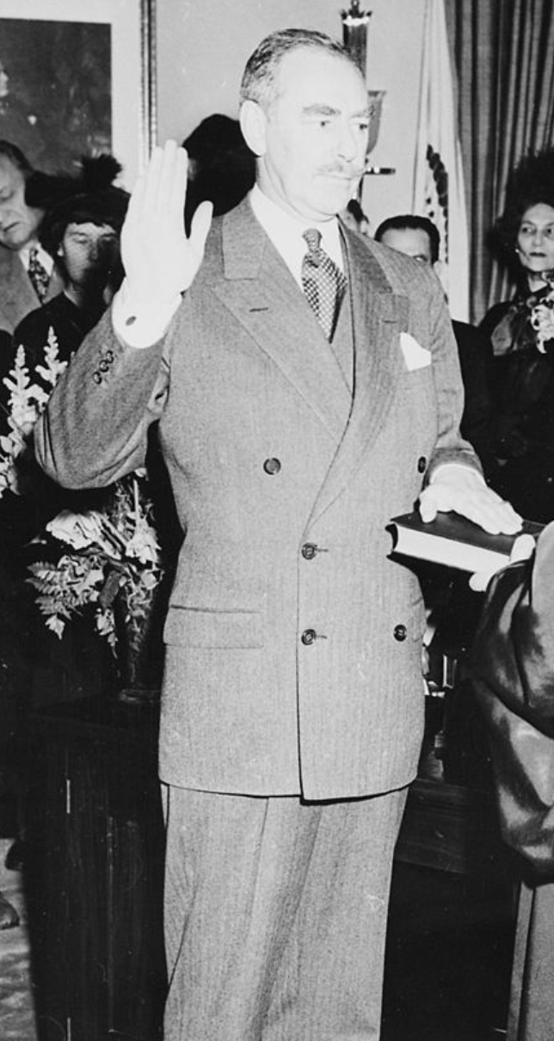
Plus Acheson
Dean Acheson, Secretary of State for Harry S Truman:
On the Republican Party as the party of wealth, enterprise, and opportunity:
“This business base of the Republican Party is stressed not in any spirit of criticism. The importance of business is an outstanding fact of American life. The achievements of business have been phenomenal. It is altogether appropriate that one of the major parties should represent its interests and its point of view…”
The subsequent transformation of the Republican Party from those who were going to become millionaires, or become even greater millionaires; to those who fear that they would lose it all…

Slide 101
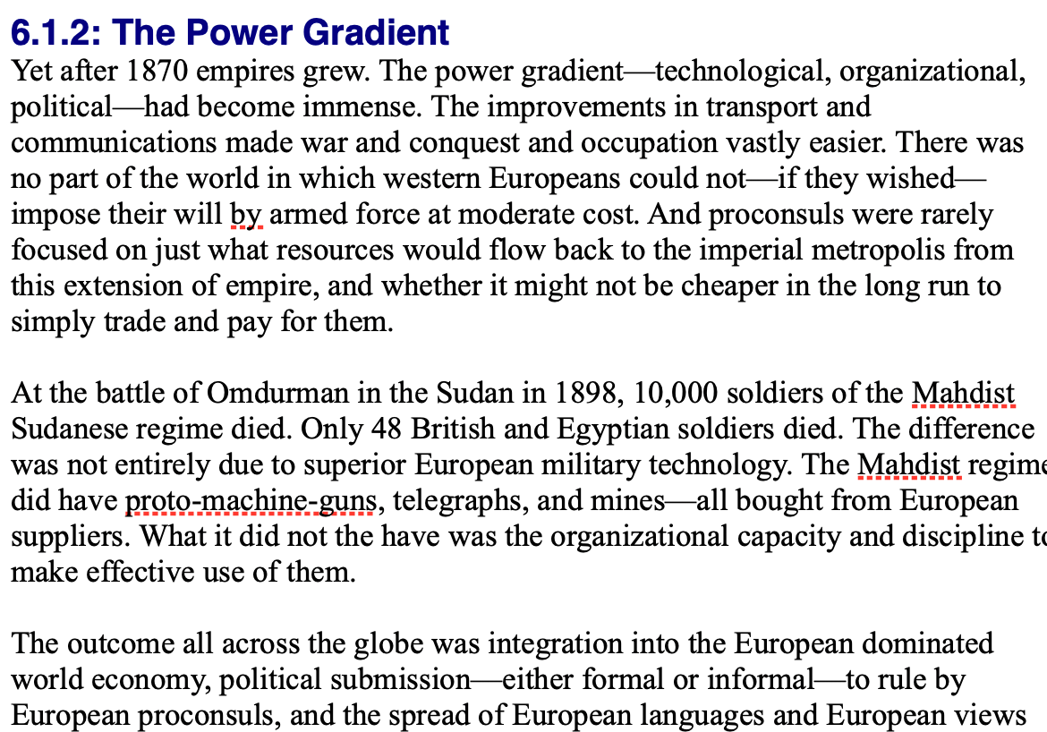
Review: Empire
By 1810 the tide of empire had been clearly ebbing…
But then things turned around: the power gradient:

Slide 102
To Your iClickers!
According to Eichengreen, graphing international capital flows and mobility since 1850 over time produces a graph that is:
V-shaped
U-shaped
W-shaped
An upward line
None of the above

Slide 103
To Your iClickers!
According to Eichengreen, the responsibilities of a pre-World War I central bank as steward of the global gold standard and also as lender-of-last-resort in domestic financial crises were:
in complete harmony
in irresolvable tension
for the most part manageable, before World War I at least, via fancy footwork and good luck
not understood
none of the above

Slide 104
To Your iClickers!
According to Eichengreen, the experience of being on the gold standard for North Atlantic economies in the 1870-1914 period was by and large a happy one, and the experience of countries at the world economy’s periphery was:
also by and large a happy one.
a mixed one.
a source of considerable tension, instability, and political upset.
once again, manageable with fancy footwork and a little good luck.
none of the above.

Slide 105
To Your iClickers!
In Eichengreen’s view, if World War I had somehow been avoided, would the global gold standard have remained stable in the 1920s and 1930s?
There are no guarantees, but probably yes.
There are no guarantees, but probably no.
Certainly not!
Certainly yes—unless several North Atlantic economies experienced a socialist revolution
None of the above.

Slide 106
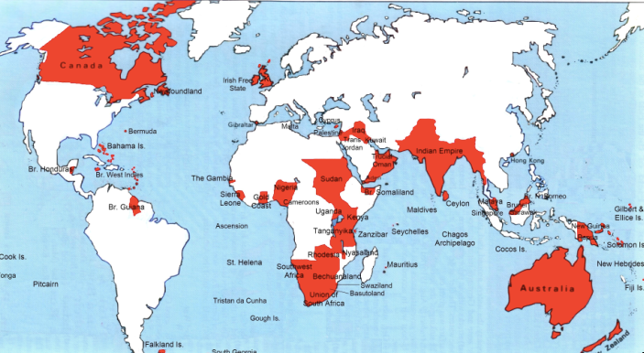
Empire

Slide 107
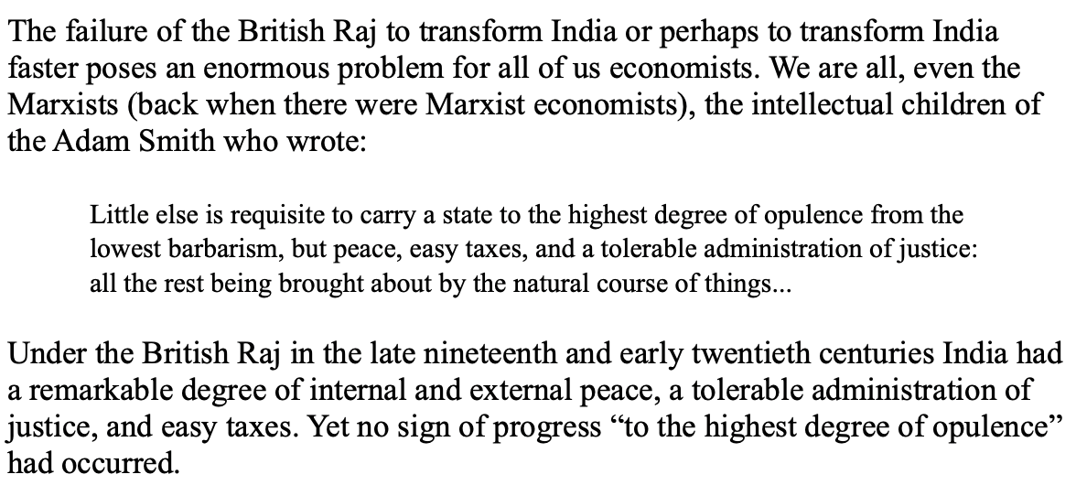
India
Why didn’t the British transform India into an industrial power?

Slide 108
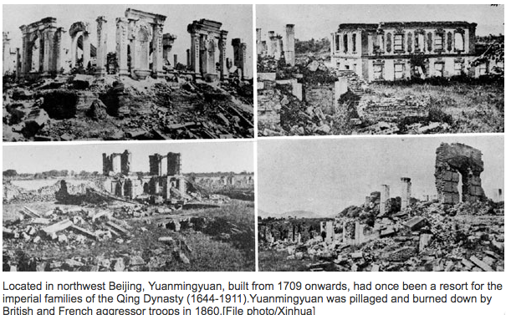
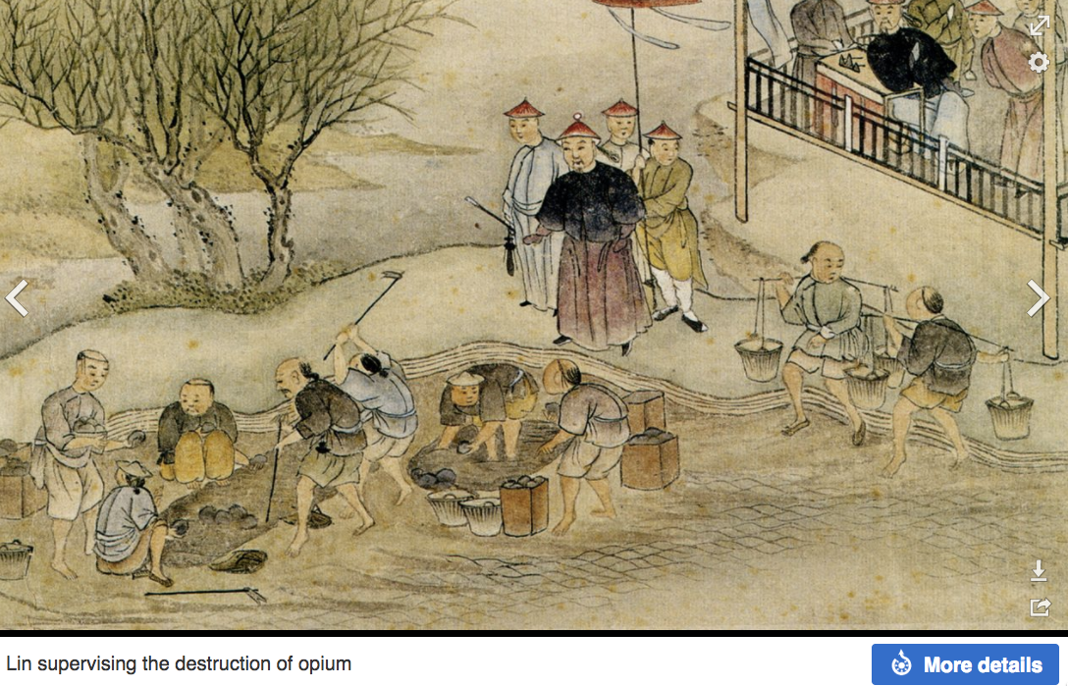
“Self-Strengthening”
The puzzle of China vs. Japan
Great Qing (大清)(1644-1912)
Wu Sangui (吳三桂)
The Rebellion of the Three Feudatories (三藩之亂)
Kangxi and Qianlong: “revere the emperor and expel the barbarians” is difficult to pursue when the emperor and his clan identify themselves as “barbarians”
Tai-Ping Rebellion (太平天國運動)
Cixi ( 慈禧太后)
Li Hongzhang (李鴻章)the Kai-Ping coal mine, Chang Yen-Mao, and Herbert Hoover

Slide 109
Formal Empires
There were, broadly, three views as to why European late-1800s empires rose to such domination, each of which with its own view of what was to be done to fix the situation:
One view is that of John Hobson: The major economic problem was the business cycle. Equipping the military needed to maintain the empire puts people to work. And an empire is a good source of consumers for the products of domestic factories. European governments that pursued empire, Hobson thought, were less likely to face economic distress and so more likely to continue in office.
A second view was that of Joseph Schumpeter: imperialism as the last gasp of military status aristocracy.
The third view was that empires were ordained by God—or at least morally required or desirable, for European powers had a civilizing mission. The Europeans were lucky enough to be the grownups, and it was the obligation of the grownups to civilize the world. But perhaps civilization is best spread by newspapers and books and merchants and engineers, rather than by alien proconsuls? Just a thought.

Slide 110
Informal Empires
But even where Britain (or France, or Germany, or Portugal, or Spain, or those who thought of themselves as descended from the conquistadores of Castile, or Anglo-Saxon settlers) did not rule, they reigned:
Britain seemed successful: playing by Britain’s rules seemed wise…
Britain was powerful: playing by Britain’s rules seemed likely to keep it from getting annoyed…
Britain was working very hard to make itself attractive—to make becoming a Briton-by-proxy of some sort straightforward and profitable in both money and cultural terms…
Britain was the first-mover hegemon: international cooperation was on its terms…

Slide 111
Catch Our Breath…
Comments?
Questions?

Slide 112
Review: Revolutions
“Petty Officer Lemmgen… arrived at the Ministry [of War]… found… Lieutenant HambuRger.... Lemmgen produced a typed document with the following text: ‘Comrades and Workers! The Ebert-Scheidemann government have made themselves impossible.... The undersigned Revolutionary Council has provisionally assumed power.’
“Lieutenant Hamburger inspected the document and became properly indignant. ‘But where are the signatures? Before I can comply with this order, you’ll have to go back and get it properly signed. Otherwise any little shorthand typist could declare the government deposed.’ Petty Officer Lemmgen... saw the logic…. So he and his men saluted... and made their way back to the Revolutionary Council to obtain the necessary signatures....
“But by the time he had obtained the signatures, Lemmgen had learned that the People’s Naval Division had declared itself neutral. So he did not return to the Ministry of War…”

Slide 113
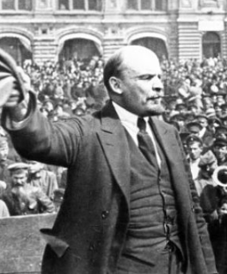
Lenin
A quick power grab…
Confidently expecting a German revolution, and then massive aid…
Brutal civil war
Kerenskyites
Reds
Whites
Nationalists
What was the revolutionary government to do?
Ludendorff’s German war economy…

Slide 114
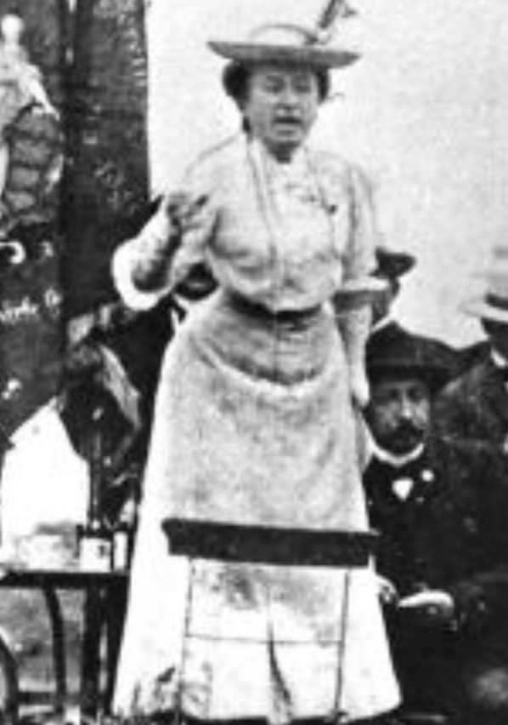
Red Rosa on Lenin
“Without general elections, without unrestricted freedom of press and assembly, without a free struggle of opinion, life dies out in every public institution…. Only the bureaucracy remains…. A few dozen party leaders of inexhaustible energy and boundless experience direct and rule….
“An elite of the working class is invited from time to time to meetings where they are to applaud the speeches of the leaders, and to approve proposed resolutions unanimously–at bottom, then, a clique affair…. Such conditions must inevitably cause a brutalization of public life: attempted assassinations, shooting of hostages, etc…
“Freedom only for the supporters of the government, only for the members of one party–however numerous they may be–is no freedom at all. Freedom is always and exclusively freedom for the one who thinks differently. Not because of any fanatical concept of “justice” but because all that is instructive, wholesome and purifying in political freedom depends on this essential characteristic, and its effectiveness vanishes when ‘freedom’ becomes a special privilege…

Slide 115

Review: The U.S.: The Roaring Twenties
The boom of the 1920s
Mass production—the flowering of the Second Industrial Revolution
“The business of America is business”
Structural changes in the 1920s…

Slide 116
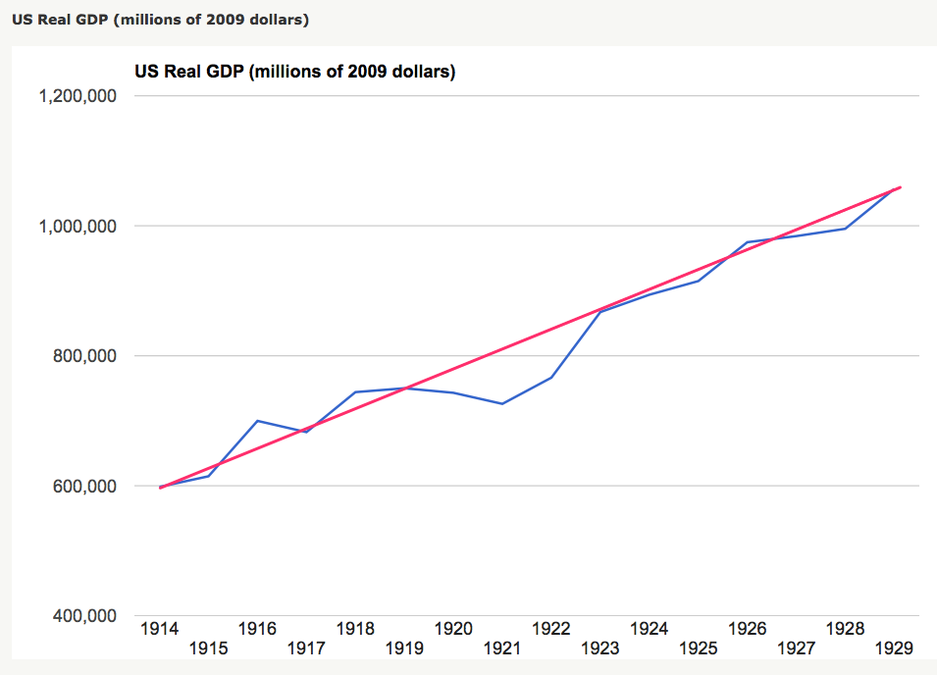
Structural Changes in the 1920s
Mass production—Henry Ford and the Model T
End of mass immigration—immigration restrictions of 1924
What do these do to the demand for construction, and construction workers?
The role of the stock market…
The role of the banking system…

Slide 117
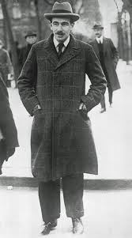
Review: To Your iClickers
John Maynard Keynes thought that the prosperity of the pre-WWI years was:
Natural and stable: a logical development out of human drives that went from strength to strength, and could only be overthrown by a very unlikely disaster.
Artificial and unstable, and based on a very complicated system in which, largely by chance, a lot happened to go right.
Natural but unstable, in that it was a logical development out of humanity’s trading nature but could be disturbed by other human drives—like tribalism, and the lust for domination.
Artificial but stable, as constructed by the greatest minds of the age, and only overthrown by a very unlikely disaster.
None of the above

Slide 118
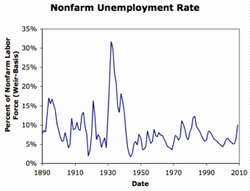
Review: Why the “Perfect Storm” of 1929-1933?
Previous Cycles:
1873—railroad
1884—railroad redux
1893—free silver
1904—Northern Securities
1907—gold drain to Britain
1914—disruption of the start of WWI
1920—deflation; return to “normalcy”
What brought previous downturns to a halt?
What made the Great Depression so great?

Slide 119
General Glut
How is it that there can be a "general glut" in which pretty much every produced commodity and the labor of workers are in excess supply, given that humans are far from satiated with production goods and given that one person's expenditure is another person's income?
Remember: you can take your income and use it either to buy things that are useful or to build up your stock of cash money. If there is excess demand for useful commodities, people can switch from producing whatever they were making to producing whatever is in short supply.
But the only way to build up your stock of cash is to try to cut your spending below your income. And since one person's spending is another person's income, that simply cannot be done in general.
If people in general try, the result is that spending and incomes fall economywide until they are both at such a low level that people de-prioritize building up their cash holdings.

Slide 120
What Had Ended Previous Downturns?
Previous Cycles:
1873—RR investment drops to zero
1884—RR investment drops to zero
1893—confidence that gold standard will be kept
1904—Theodore Roosevelt
1907—J.P. Morgan constitutes himself a pick-up central bank
1914—profits from European war demand WWI
1920—Federal Reserve reverses course

Slide 121
Interwar Gold Standard
The interwar gold standard caused, deepened, and definitely did nothing toward curing or ameliorating the Great Depression?
There is nothing worse than attempting to credibly commit to an incredible policy
The fear that the gold standard would break down caused people to want to hoard cash—to build up their cash holdings.
The fear that the gold standard would break down caused governments to be extremely unwilling to boost their economies' cash supplies—such boosts might, governments feared, undermine confidence that their country would stay on the gold standard.
Big depressions happen when the popular demand for cash outstrips the government's supply
The interwar gold standard was thus a powerful motivator and stage-setter pushing both people and governments into the patterns of behavior that produced the Great Depression

Slide 122
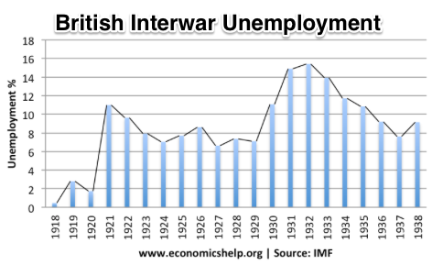
“Crying ‘Fire! Fire!’ in Noah’s Flood…”
France gold acquisition policy
American gold acquisition policy
The weakness of the gold-exchange standard—that people knew the gold standard could and would be abandoned
Labor-side pressure…
Nothing worse than an attempt to credibly commit to an incredible policy…
And then the belief that inflation was always just around the corner…

Slide 123
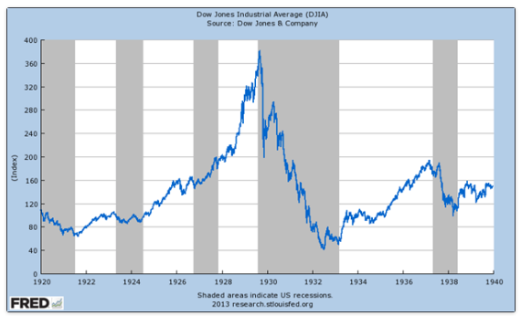
The Role of the Stock Market
Stock market doubles between the start of 1927 and late 1929
Positive-feedback margin trading
And a large number of people coming into the market who do not understand what is going on
Castles in the air
Prohibition?
Monetary policy?
Mass production?
The expectations shock produced

Slide 124
Why Was the Great Depression so Great?
John Maynard Keynes:
“When once the recovery has been started, the manner in which it feeds on itself and cumulates is obvious. But during the downward phase, when both fixed capital and stocks of materials are for the time being redundant and working-capital is being reduced, the schedule of the marginal efficiency of capital may fall so low that it can scarcely be corrected, so as to secure a satisfactory rate of new investment, by any practicable reduction in the rate of interest.
“Thus with markets organised and influenced as they are at present, the market estimation of the marginal efficiency of capital may suffer such enormously wide fluctuations that it cannot be sufficiently offset by corresponding fluctuations in the rate of interest. Moreover, the corresponding movements in the stock-market may, as we have seen above, depress the propensity to consume just when it is most needed. In conditions of laissez-faire the avoidance of wide fluctuations in employment may, therefore, prove impossible without a far-reaching change in the psychology of investment markets such as there is no reason to expect.
“I conclude that the duty of ordering the current volume of investment cannot safely be left in private hands….”

Slide 125
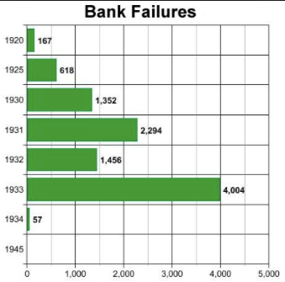
The Role of the Banking System
In the United States in the 1920s, about 600 banks failed a year—largely small rural banks
But banks set out to make riskier and riskier loans
Do they count on rescue from the Federal Reserve?
And when the Great Depression hits, bank failures rise to previously-unimaginable heights
Is there anything that could do more to boost the demand for or reduce the supply of cash?
And so call forth a general glut?
Lenders of “last resort”?

Slide 126
The Presumption Before the Great Depression
The presumption before the Great Depression that the government was not responsible for managing and curing the business cycle…
Two strands reinforced each other.
The first was the strength of the idea of laissez-faire: that government (protecting property and enforcing contracts aside) was overwhelmingly a problem and not a solution. As John Maynard Keynes wrote in his essay The End of Laissez-Faire, a powerful drive behind that was: “the corruption and incompetence of eighteenth-century government…. Almost everything which the State did in the eighteenth century in excess of its minimum functions was, or seemed, injurious or unsuccessful. [And] on the other hand, material progress between 1750 and 1850 came from individual initiative…”
The second was social Darwinism—that, in the words of steelmaster Andrew Carnegie, the second-richest man in America circa 1905 and a man who gave away his entire fortune: “The price we pay for [our civilization]... is, no doubt, great.... The employer of thousands is forced into the strictest economies... [in] the rates paid to labor.... The law of competition... is here; we cannot evade it; no substitutes for it have been found; and while the law may be sometimes hard for the individual, it is best for the race, because it insures the survival of the fittest in every department..."
The result was a dominant belief—at least among the rich and powerful—that:
The market giveth, the market taketh away: blessed be the name of the market.

Slide 127
The Hoover Administration’s Reaction to the Great Depression
The 1929-1933 Hoover administration believed that little could be done.
That the only good things that could be done were to (a) repeatedly state that "prosperity is just around the corner" and (b) try to cut federal government spending and raise taxes in order to restore confidence and scotch the fear of high inflation.
As economist R.G. Hawtrey wrote, to worry about inflation in the midst of the Great Depression was like "crying 'FIRE! FIRE!' in Noah's Flood..."
Herbert Hoover himself wrote afterwards about how his administration had been dominated by the "'leave-it-alone liquidationists' headed by Secretary of the Treasury Mellon, [who] felt that government must keep its hands off and let the slump liquidate itself. Mr. Mellon had only one formula:
'Liquidate labor, liquidate stocks, liquidate the farmers, liquidate real estate'. He held that even panic was not altogether a bad thing. He said: 'It will purge the rottenness out of the system. High costs of living and high living will come down. People will work harder, live a more moral life. Values will be adjusted, and enterprising people will pick up the wrecks from less competent people'…"
Hoover went on to state that he did not share this view…
That raises lots of questions about how his administration worked…

Slide 128
To Your iClickers
The largest automobile manufacturer in the world in 1928 was:
Toyota
Daimler-Benz
Peugeot
Ford
General Motors

Slide 129
To Your iClickers…
Worldwide, the Great Depression was was:
In relative terms, equalled by the Cleveland Depression of 1893-6
In relative terms, smaller than the depression that followed the Crash of 1873
In relative terms, equalled by the Great Recession of 2008-2020
In relative terms, by far the largest depression ever
None of the above

Slide 130

Review: New Deals
Japan: Takahashi Korekiyo
moved early to maintain full employment
Britain: MacDonald-Snowden-Baldwin
Forced off…
Germany: Adolf Hitler
Succeeds Bruening
America: Franklin Delano Roosevelt
Succeeds Herbert Hoover
France: Leon Blum

Slide 131
Recovery
Japan recovered the fastest,
Germany second,
Britain third,
The U.S. fourth,
France last.
By-and-large, the sooner you abandon the gold standard, expand the money supply, and undertake a "New Deal" to boost government spending, the better…

Slide 132
The Polanyian Perplex
People believe that the rights they have are broader and deeper than simply property rights, but the market economy disagrees.
Thus either governments will find a way to guarantee their populations these extra rights to community stability, general prosperity, and full employment, or society will react somehow against the liberal market-oriented political-economic system.
“Fictitious commodities”:
Land
Labor
Finance
Society’s “double movement”

Slide 133
The Permanent Problem of the Human Race
John Maynard Keynes thought that the economic problem would not be the "major problem of the human race"
By the end of the twentieth century the human race would be so rich that people would be practically satiated with commodities.
Thus the "economic problem" of how to economize and be efficient, and allocate scarce means among alternative uses, was not the permanent problem of the human race.
Instead, "for the first time since his creation man will be faced with his real, his permanent problem-how to use his freedom from pressing economic cares, how to occupy the leisure, which science and compound interest will have won for him, to live wisely and agreeably and well.... It will be those peoples, who can keep alive, and cultivate into a fuller perfection, the art of life itself and do not sell themselves for the means of life, who will be able to enjoy the abundance when it comes..."
Yet Keynes was not sure that having to confront this problem would be a net plus for humanity: "Will this be a benefit? If one believes at all in the real values of life, the prospect at least opens up the possibility of benefit. Yet I think with dread of the readjustment of the habits and instincts of the ordinary man, bred into him for countless generations, which he may be asked to discard within a few decades..."

Slide 134
Digression: How to Study
Will I ask you about Jan Christian Smuts? About the prayer (and theology) of the Grigua?
No…
Themes and concepts…
But you need narratives and stories to hang onto them…
And our brains are very good at deep-sixing useless information
Andy Matuschak: Why Books Don’t Work <https://andymatuschak.org/books/>:
“Picture some serious non-fiction tomes. The Selfish Gene; Thinking, Fast and Slow; Guns, Germs, and Steel; etc.
“Have you ever had a book like this—one you’d read—come up in conversation, only to discover that you’d absorbed what amounts to a few sentences? I’ll be honest: it happens to me regularly. Often things go well at first. I’ll feel I can sketch the basic claims, paint the surface; but when someone asks a basic probing question, the edifice instantly collapses. Sometimes it’s a memory issue: I simply can’t recall the relevant details. But just as often, as I grasp about, I’ll realize I had never really understood the idea in question, though I’d certainly thought I understood when I read the book. Indeed, I’ll realize that I had barely noticed how little I’d absorbed until that very moment. I know I’m not alone here…

Slide 135
Skipped Topic: Pre-1914 Political Economy: Over in Europe
The June Days of 1848 in Paris:
Tocqueville:
“The insurrection of June [1848]... class against class... a blind and rude, but powerful, effort on the part of the workmen to escape from the necessities of their condition, which had been depicted to them as one of unlawful oppression…. The closing of the national workshops… occasioned the rising…”
“Thousands… hastening to our aid from every part of France.... Thanks to the railroads, some had already come from fifty leagues’ distance... every class of society... peasants... shopkeepers... landlords and nobles all mingled together... they rushed into Paris with unequalled ardour: a spectacle as strange and unprecedented in our revolutionary annals.... The insurgents received no reinforcements, whereas we had all France for reserves…”

Slide 136
French Politics
Régimes stability is not on the menu:
the terrorist dictatorship of the Jacobins (the mainspring of popular government… amid revolution it is at once virtue and terror: virtue, without which terror is fatal; terror, without which virtue is impotent…)
a corrupt and gerrymandered 5-man executive of the Directory, defended on October 5, 1795 by the “whiff of grapeshot” of Napoleon Bonaparte and Joachim Murat, that managed to generate the first modern hyperinflation, defended itself against a royalist coup plotted by two of its five members (Barthelemy and Carnot) and its most successful general (Pichegru), and was then overthrown by the same Napoleon in 1799.
a dictatorship, with Napoleon Bonaparte as “First Consul”, until 1804.
an empire, with Napoleon Bonaparte as Emperor of the French, until suppressed by the other European powers in 1815.
a restored Bourbon monarchy, with first Louis XVIII and then Charles X, until 1830.
an alternative Orleanist monarchy, with King Louis-Philippes as the king-citizen, overthrown in 1848.
a second republic, overthrown by its own president, Napoleon’s nephew Louis Napoleon, which collapsed under pressure of military defeat in 1870.
a socialist commune, in Paris at least.
a third republic, which suppressed the commune—but promptly chose a royalist Marshal MacMahon, as president.
a failed attempt by third republic president Marshal MacMahon to replace himself by a King Henry V.
a failed attempt by the ex-Minister of War Georges Boulanger to seize power for his RRR movement: Revanche, Révision, Restauration (revenge on Germany, revision of the constitution, restoration of the monarchy).

Slide 137
Left-Wing Normal European Politics I
Disjunction between policies and rhetoric:
The Socialist Party of Germany’s Erfurt and Gotha programs seek things like: holidays for elections, two-year legislative terms, the right to bear arms, equal rights for women, the prohibition of spending public funds for religious purposes, free public schools and colleges, free medical care including midwifery, an eight-hour working day, no child labor under 14, a 36-hour minimum weekend, an occupational safety and health administration…

Slide 138
Left-Wing Normal European Politics II
Disjunction between policies and rhetoric:
But also: “By every lawful means to bring about a free state and a socialistic society, to effect the destruction of the iron law of wages by doing away with the system of wage labor.” And they sought: “the transformation of the capitalist private ownership of the means of production—land and soil, pits and mines, raw materials, tools, machines, means of transportation—into social property and the transformation of the production of goods into socialist production carried on by and for society.” And they believed: “This… emancipation… of the entire human race…. But it can only be the work of the working class, because all other classes… have as their common goal the preservation of the foundations of contemporary society.”

Slide 139
Center and Right-Wing Normal European Politics
The touchstone was “fairness”: it was not fair that those who did not work hard and did not play by the rules got lots of good things:
Those who did not play by the rules could be on either end of the wealth-and-power spectrum:
Parasitic aristocrats and cruel plutocrats
Those poor who wanted something for nothing, or got above their station
A middle-class, social order movement
Focus voters’ attention on the disruptive utopian aspirations of the left, and electoral coalitions could be preserved…
Preserve as much as possible of old orders of hierarchy in changing times:
Reform to preserve; change so things could stay the same
Find new reasons why hierarchy is good: social darwinism

Slide 140
Magnifying Non-Economic Cleavages Had Dangers
Society under threat not by economic inequality but by social disorder—or aliens—or other nations. Plus:
A right-wing landed and bureaucratic upper class that had, by and large, lost its social role.
A belief by politicians anxious to paper over class divisions that they could be papered over with national or ethnic unity.
A growing social-darwinist current that struggle was good, and the victors should be rewarded
Even or especially military struggle by peoples-in-arms, over not what language a province would be administered in but who would live there
These stored up trouble as 1914 approached.
In 1919 John Maynard Keynes was to write, bitterly, that he, his peers, and his elders had regarded:
“the projects and politics of militarism and imperialism, of racial and cultural rivalries, of monopolies, restrictions, and exclusion, which were to play the serpent to this paradise… [as] little more than the amusements of his daily newspaper…”

Slide 141

Skipped Topic: Passing the Baton: From Britain to America
The Industrial Revolution took place in Britain
The standard explanation four or five largely independent strands coming together.:
Limited government, security of property, and freedom of contract
Science and the technological tradition of sustained inquiry
Victory in the wars of the Commercial Revolution era
Machinery making, "tinkering", and "gadgets"—primarily made out of metal.
Coal in Britain—the only thing that made a steam engine potentially profitable.
Plus high elasticity of demand for leading-sector products…
http://bradford-delong.com brad.delong@gmail.com

Slide 142
iClickers: Why Breaktrhrough?
The principal reason that the Industrial Revolution took place in late eighteenth century Britain (rather than in Sung China, or Abbasid Baghdad, or Antonine Dynasty Rome, or during the Hellenistic Age) is:
A lack of human numbers thinking about problems of production
A lack of good means of communication—e.g. printing—for diffusing information about how to solve problems of production
A lack of experience using coal as an energy source
A lack of the incentive created by high real wages leading to a strong desire to make labor more productive
None of the above/not enough information
http://bradford-delong.com brad.delong@gmail.com

Slide 143
iClicker: Why Passing the Baton
The principal reason that the twentieth century was an American rather than a second British century was:
The United States’s aggressive and enthusiastic welcome of immigrants
The United States’s focus on broad-based technical education
The United States’s extraordinary abundance of natural resources driving high real wages and enormous incentives to build machines to manipulate matter
A U.S. government that took industrial development as a key policy goal, rather than being comfortable with laissez-faire
None of the above/not enough information
http://bradford-delong.com brad.delong@gmail.com

Slide 144

British Productivity Growth Acceleration
http://bradford-delong.com brad.delong@gmail.com

Slide 145

But Even in the First Half of the Nineteenth Century the U.S. Was Outpacing Britain in Growth…
Even in the first half of the nineteenth century—the period in which the British Industrial Revolution made it the wonder of the world—economic growth in the United States was proceeding faster than in Britain.
While British real GDP per capita was increasing at less than 0.6 percent per year
American was growing at a hair over one percent per year.
And a significantly larger share of GDP was going to the white working class in the United States, in the north at least:
The extraordinary abundance of land and the possibility of "lighting out for the territory", in the words of American author Mark Twain, gave even workers without property or notably scarce skills substantial economic bargaining power.
http://bradford-delong.com brad.delong@gmail.com

Slide 146
And Starting in the Late Nineteenth Century
Second Industrial Revolution…
Why the U.S. and Germany, and not Britain?
Immigration and Population
Was resource scarcity no longer a factor?
Was the differential in the growth rate h of the stock of useful economic knowledge even greater than the differential in the growth rate g of the efficiency-of-labor?
http://bradford-delong.com brad.delong@gmail.com

Slide 147
Phases of American Growth
1.0% per year in GDP per capita from 1760-1860: resource abundance
1.6% per year in GDP per capita from 1860-1929:
“Great traverse”: K/Y ratio up from 2.5 to 4
Half of it an increase in savings rates
Half of it a fall in the price of capital goods
2.5% per year in GDP per capita from 1929-1973
“Fordism”
Expected further acceleration: it did not happen
Post-1973
Productivity slowdown 1973-1995 (environment, oil, baby boom, feminism)
“New economy” 1995-2006
Post-2006 collapse of growth
http://bradford-delong.com brad.delong@gmail.com

Slide 148

American Productivity Growth Acceleration
http://bradford-delong.com brad.delong@gmail.com

Slide 149

Early Nineteenth Century: Westward Expansion
Westward expansion
The “American System”
Abundant natural resources
Very high real wages
Focus on raising labor productivity
Hence fast efficiency-of-labor growth
Britain, by contrast, focused on economizing on (non-coal) raw materials
http://bradford-delong.com brad.delong@gmail.com

Slide 150
The Importance of Resources 1760-1860
Major westward expansion and "Amerindian removal”
The century 1760 to 1860 before the Civil War.
We have U.S. output-per-worker growth then at about 1.0% per year…
…in contrast to British output-per-worker growth at about 0.5% per year.
We have the U.S. population and labor force growing at 2.5% per year…
…from 2.5 to 30 million.
http://bradford-delong.com brad.delong@gmail.com

Slide 151


The Importance of Resources 1760-1860
Recall our basic Solow Model:
http://bradford-delong.com brad.delong@gmail.com

Slide 152

The Importance of Resources 1760-1860
Recall our basic Solow Model:
Assume K/Y constant, so the growth rate g of the efficiency of labor and the growth rate of output-per-worker are the same:
http://bradford-delong.com brad.delong@gmail.com

Slide 153
The Importance of Resources 1760-1860
Recall our basic Solow Model:
Assume K/Y constant, so the growth rate g of the efficiency of labor and the growth rate of output-per-worker are the same:
http://bradford-delong.com brad.delong@gmail.com

Slide 154
The Importance of Resources 1760-1860
Recall our basic Solow Model:
Assume K/Y constant, so the growth rate g of the efficiency of labor and the growth rate of output-per-worker are the same:
Let’s, last, fit this to history in the century before the 1860 election of President Abraham Lincoln and the ensuing American Civil War:
http://bradford-delong.com brad.delong@gmail.com

Slide 155

The Importance of Resources 1760-1860
Recall our basic Solow Model:
Assume K/Y constant, so the growth rate g of the efficiency of labor and the growth rate of output-per-worker are the same:
Let’s, last, fit this to history in the century before the 1860 election of President Abraham Lincoln and the ensuing American Civil War:
http://bradford-delong.com brad.delong@gmail.com

Slide 156

Westward Expansion
http://bradford-delong.com brad.delong@gmail.com

Slide 157

The Importance of Resources 1760-1860
We have two parameters left: γ and h, the weight of ideas in efficiency-of-labor growth and the rate of growth of the stock of useful ideas for the economy in American heads, respectively:
http://bradford-delong.com brad.delong@gmail.com

Slide 158

The Importance of Resources 1760-1860
We have two parameters left: γ and h, the weight of ideas in efficiency-of-labor growth and the rate of growth of the stock of useful ideas for the economy in American heads, respectively:
http://bradford-delong.com brad.delong@gmail.com

Slide 159
The Importance of Resources 1760-1860
Thus if γ→∞ then h→0.010
http://bradford-delong.com brad.delong@gmail.com

Slide 160
The Importance of Resources 1760-1860
Thus if γ→∞ then h=0.010
Thus if γ=3.0 then h=0.00667
http://bradford-delong.com brad.delong@gmail.com

Slide 161
The Importance of Resources 1760-1860
Thus if γ→∞ then h=0.010
Thus if γ=3.0 then h=0.00667
Thus if γ=1.0 then h=0.00
http://bradford-delong.com brad.delong@gmail.com

Slide 162
The Importance of Resources 1760-1860
Thus if γ→∞ then h=0.010
Thus if γ=3.0 then h=0.00667
Thus if γ=1.0 then h=0.00
Looking across the Atlantic Ocean to Great Britain, we see that over there it is indeed the case that h=0.005 from 1760 to 1860. Faster growth of h in America due to some catchup with the world's first and leading industrial nation seems likely. So γ=3.0 has some claim to be the most likely value…
http://bradford-delong.com brad.delong@gmail.com

Slide 163
A Counterfactual
The Royal Proclamation of October 1763:
Our Royal Will and Pleasure… no... Governor or Commander in Chief in... our... Colonies or Plantations in America do... grant Warrants of Survey, or pass Patents for any Lands beyond the Heads or Sources of any of the Rivers which fall into the Atlantic Ocean from the West and North West, or upon any Lands whatever, which, not having been ceded to or purchased by Us as aforesaid, are reserved to the said Indians, or any of them...
http://bradford-delong.com brad.delong@gmail.com

Slide 164

What If This Royal Proclamation Had Stuck?
What if ρ=0?
If γ → ∞ and h=0.010 then g=0.01
If γ=3.0 and h=0.00667 then g=−0.00125
If γ=1.5 and h=0.000 then g=−0.01
http://bradford-delong.com brad.delong@gmail.com

Slide 165
What If This Royal Proclamation Had Stuck?
What if ρ=0?
If γ → ∞ and h=0.010 then g=0.01
If γ=3.0 and h=0.00667 then g=−0.00125
If γ=1.5 and h=0.000 then g=−0.01
An America penned behind the Appalachians would probably have seen its living standards and productivity levels not growing at 1% per year from 1760 to 1860 but shrinking.
For γ=3.0, living standards and productivity levels would have shrunk at a pace of -0.125% per year
http://bradford-delong.com brad.delong@gmail.com

Slide 166
What If This Royal Proclamation Had Stuck?
What if ρ=0?
Of course, a poorer America would probably have seen fewer immigrants.
But it might not have seen that many fewer immigrants.
It would no longer have been quite as attractive to move from Britain to America over 1760 to 1860.
But it still would have been very attractive to move from France, Germany, Scotland—or most of all from Potato Blight-ridden Ireland...
In what other ways might this counterfactual alternate-history "little America" would likely have been different in 1860 than America actually was?
http://bradford-delong.com brad.delong@gmail.com

Slide 167

“Trail of Tears’
http://bradford-delong.com brad.delong@gmail.com

Slide 168
A large chunk of America's pre-1860 visible growing prosperity was based not just on African-American slavery, but also on "Amerindian removal"
http://bradford-delong.com brad.delong@gmail.com

Slide 169
Catch Our Breath…
Ask me two questions…
Make two comments…

Slide 170

Late Nineteenth-Early Twentieth Century: “Great Traverse”
Invention of the industrial research lab
First globalization
Technologies of Second Industrial Revolution
Economies of scale and mass production
Falling price of capital goods
Greater savings effort
Plus mass immigration
Rapidly rising inequality
Or was it? Emancipation…
http://bradford-delong.com brad.delong@gmail.com

Slide 171
Capital Deepening
Lowered deprecation rate δ
From 5% to 3% per year
http://bradford-delong.com brad.delong@gmail.com

Slide 172
Capital Deepening
Lowered deprecation rate δ
From 5% to 3% per year
Increased savings rate s
Capital-output ratio goes from 2.5 to 4 across 70 years
http://bradford-delong.com brad.delong@gmail.com

Slide 173
Capital Deepening
Lowered deprecation rate δ
From 5% to 3% per year
Increased savings rate s
Capital-output ratio goes from 2.5 to 4 across 70 years
with an α=1, output-per-worker proportional to the capital-output ratio
ln(4/2.5)/70 = 0.007
g = 0.9%/year
http://bradford-delong.com brad.delong@gmail.com

Slide 174
Capital Deepening
Capital-output ratio goes from 2.5 to 4 across 70 years
with an α=1, output-per-worker proportional to the capital-output ratio
ln(4/2.5)/70 = 0.007
g = 0.9%/year
Second Industrial Revolution
Large managerial corporation
Large-scale investment banking
Industrial research lab
Continent-wide market
Globalization
http://bradford-delong.com brad.delong@gmail.com

Slide 175

Mid Twentieth Century: Drive to High Mass Consumption
DARPA, etc.: two heads are better than one
“Fordist” oligopolies
Second globalization
Keynesian stabilization policies
Falling and then low inequality
For white guys…
http://bradford-delong.com brad.delong@gmail.com

Slide 176
Mid Twentieth Century: Drive to High Mass Consumption
DARPA, etc.: two heads are better than one
“Fordist” oligopolies
Second globalization
Keynesian stabilization policies
Falling and then low inequality
For white guys…
http://bradford-delong.com brad.delong@gmail.com

Slide 177
Catch Our Breath…
Ask me two questions…
Make two comments…

Slide 178
Notes

